Slide 1
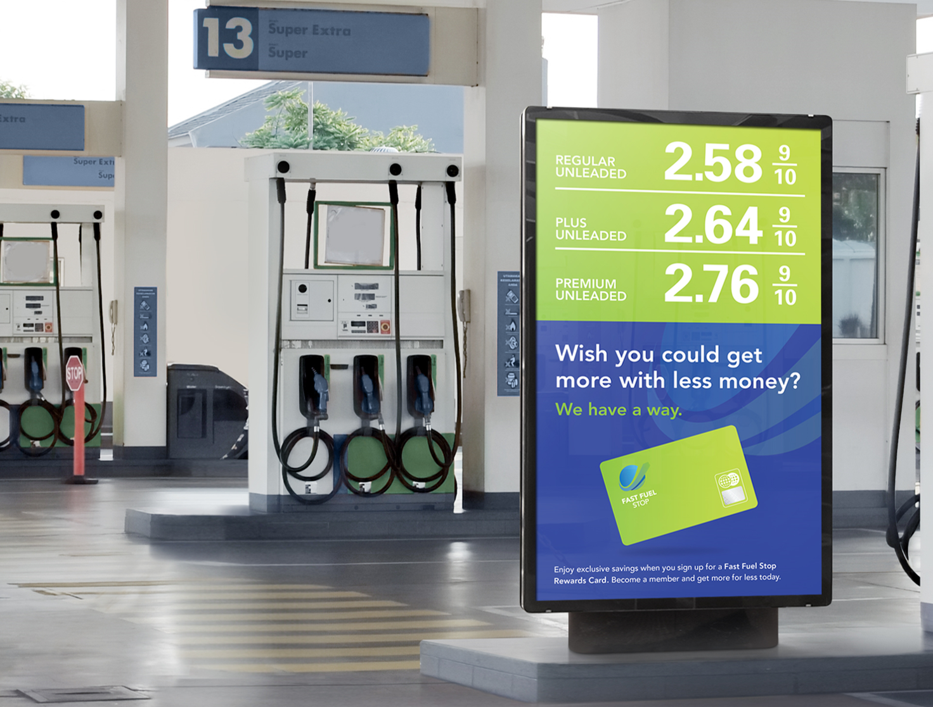
Understanding and Specifying Outdoor LFD
Q3 2019

Slide 2
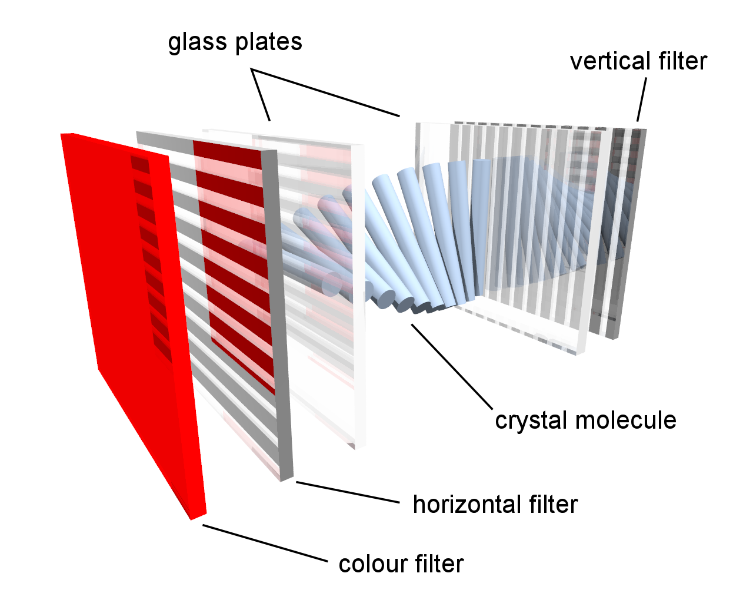
LCD - The Core Technology
When we think of displays for both indoor and outdoor applications, the most pervasive technology is LCD LFD.
By looking at how LCD technology works we can begin to see the elements that might negatively affect it in various environments.

Slide 3
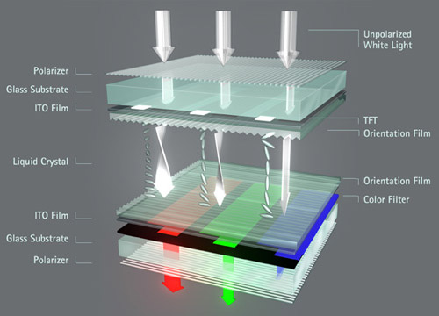
LCD Construction Principle
To create an LCD, you take two pieces of glass with polarizing films applied, which are assembled together with a carefully controlled gap between.
When liquid crystal material is introduced to this cell, the layers adjacent to the glass will align, resulting in a helical structure of molecules between the two glass plates.
As light strikes the first plate, it is polarized.
The liquid crystal molecules in each layer then guide the light through the display, changing the angle of polarization to match.

Slide 4
LCD Construction Principle
When light reaches the final layer of the crystal material its plane of polarization will have been rotated through 90 degrees and since the plane of polarization matches the plane of the polarizing film, light will be transmitted.
If we apply an electric field to liquid crystal molecules, they untwist.
When they straighten out, they change the angle of the light passing through them so that it no longer matches the angle of the top polarizing filter.
Consequently, no light can pass through that area of the LCD, which makes that area darker than the surrounding areas.

Slide 5
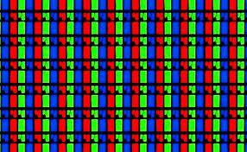
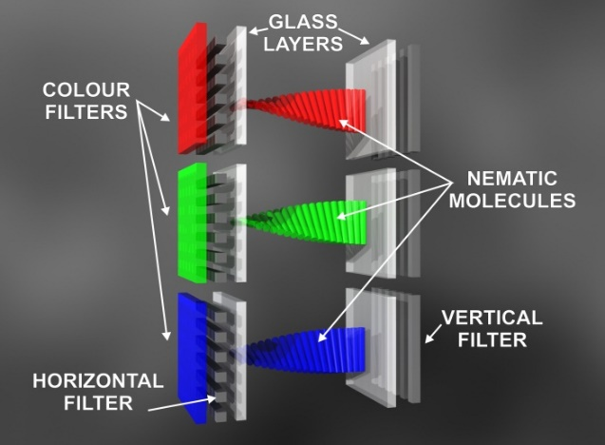
LCD Flat Panel Color Production
For an LCD monitor to produce color, each pixel on the screen has to have three sub-pixels, each being a primary color (red, blue and green).
By taking each of the three colors, and varying the intensity of each, then blending it all together, the color LCD has a large possible palette of colors.

Slide 6
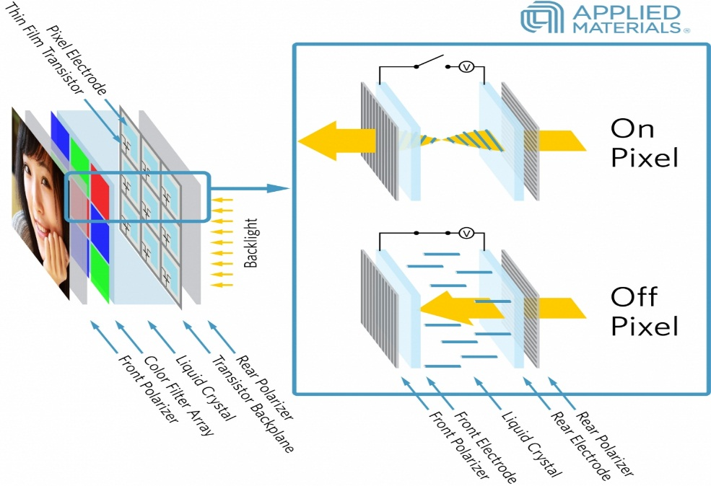
Liquid Crystal Properties and LCDs
The liquid crystals in an LCD are interesting because they don't exactly fall under the three main states of matter: solid, liquid or gas.
Liquid crystals are in a unique intermediate phase between solid and liquid.

Slide 7



Liquid Crystal Properties
Crystals behave differently than most materials. They can exist as a liquid, in a phase called isotropic, or a solid phase called smectic. Liquid crystal exists in between, in a phase known as nematic.
The nematic phase of liquid crystals is what makes LCD screens possible.
During this phase, the molecules are in no positional order, but do have a notable pattern.
This allows the molecules to flow as if they were a liquid but retain a general alignment to each other.
Isotropic
(Liquid)
Nematic
(Hybrid)
Smectic
(Solid)

Slide 8
Liquid Crystal Properties
When heated, most crystalline solids experience a transition to a different phase - to an isotropic liquid state.
When the nematic liquid crystal is heated, it turns to a true liquid – isotropic. This transition temperature is called the clearing point.
When the clearing point is achieved, the liquid crystal loses its ability to control light because of the lack of common direction for each molecule.
If the temperature reaches above the clearing point, display function may fail.
If the display gets too cold, the opposite occurs, resulting in a phase change from the nematic to the smectic state, which causes the molecules to form a solid layer.
Isotropic
Nematic
Smectic

Slide 9
Specifying Outdoor Displays

Slide 10
Specifying Outdoor Displays
There are certain specifications relative to large flat panel displays, that in many instances are overlooked.
By overlooking these specifications, you run the risk of specifying and installing a display in an inappropriate manner that at best may be inadequate, and at worst may fail entirely.
The specifications that we are speaking about are:
  Duty Cycle and Image Retention
  Brightness
  Temperature
  Humidity
  IP Rating
By understanding the parameters and limitations, of each of these specifications, you will be armed with the information to properly specify large flat panel displays for all types of environments.

Slide 11

LCD Duty Cycle
When selecting a flat panel display, you will see a rating in terms of hours a day, and days of a week, that the display is designed to run.
This is known as it’s duty cycle.
The display’s LCD panel, and internal electronics such as power supplies, are designed with this duty cycle in mind, being built to operate that number of hours per day, with periods of off time to “rest” and cool down.
If the duty cycle is exceeded, the warranty for the display may be voided, and the display may fail prematurely.
It is always important to use 24/7 rated displays for long hour duty cycle applications!

Slide 12
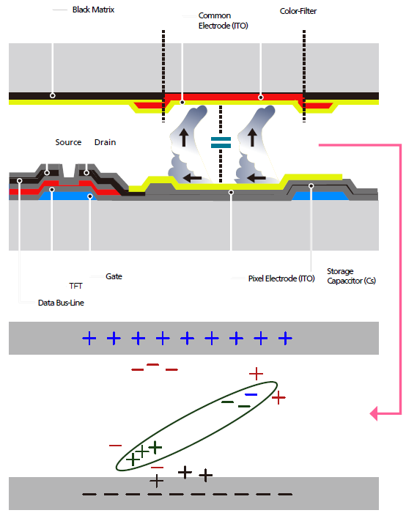
LCD Image Retention
Every display based on LCD technology, when run for an extended period of time with a fixed image on screen, can suffer from a phenomenon known as image retention.
The LCD display operates by twisting the liquid crystal structure to block or transmit light through the panel.
When a static image is left on the screen for prolonged periods of time, the twist in the liquid crystal is kept fixed in a single position.
When the liquid crystal molecules are kept still partially twisted for long periods of time, they can “stick” in that position, due to storing extra energy from the voltage forcing them to twist.
This may leave a ghost image trapped on the screen.
Over time this effect may trail off as the energy trapped in the liquid crystal drains away, however it can happen repeatedly.

Slide 13
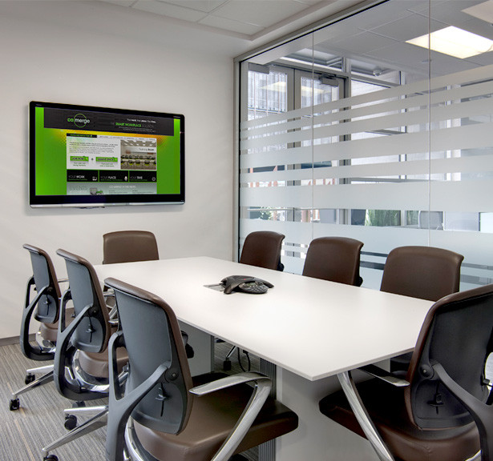
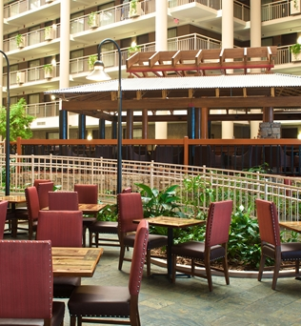
LCD Brightness
When we consider most commercial installations, the immediate display selection that comes to mind is either an LCD flat panel, or a projector.
The main issue with these technologies is one of brightness; most displays we view in public spaces simply are not bright enough for the application.
High brightness LCD displays and videowalls offer a major benefit compared to traditional flat panels, videowalls, and projection systems.
In a typical conference room where you have 30 foot candles of ambient light, a 350-400 nit LCD is fine, but outside of that kind of controlled environment, you may have many times that amount of ambient light falling on a display, necessitating a high brightness LCD.

Slide 14
Ambient Light
Ambient light, or the light present in an environment from all light sources, is the number one cause of degraded display performance in a system.
Ambient light affects image contrast by reducing the range between the dark and bright portions of the image.
Ambient light also reduces the appearance of color saturation, and degrades color accuracy.
Condition | Foot Candles
Direct Sunlight | 9,000-12,000
Full Daylight | 900-1,800
Cloudy Day | 90
Office Lights (Typical) | 30-50
Candle Light (Dark) | 1-2

Slide 15
Display Brightness VS. Ambient Light
According to SMPTE (Society of Motion Picture and Television Engineers), the ratio of display brightness and light from ambient sources should be a ratio of at least 5:1.
This is necessary for the eye to perceive a real impression of brightness and contrast.
This level of luminance is derived from the fact that SMPTE had historically indicated a target level of 50 FL for a television viewed under “normal” ambient light conditions of approximately 10 foot candles.
Although displays have evolved, the rule of thumb remains valid.

Slide 16
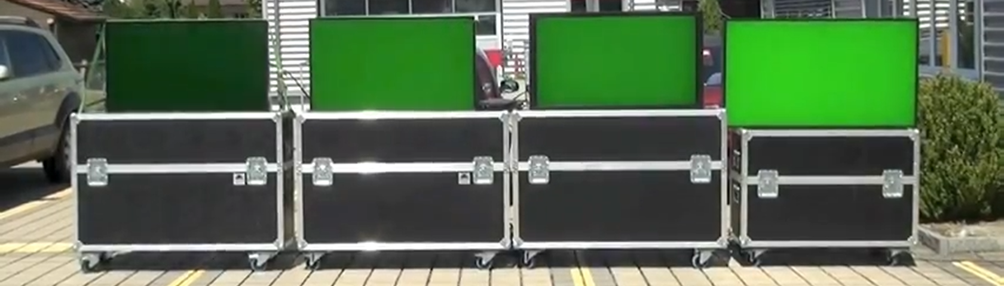
Display Brightness VS. Ambient Light
Direct sunlight comparison of LCD displays, from 1,500 nits to 5,000 nits:
1,500 Nits
2,500 Nits
3,000 Nits
5,000 Nits
We Rest
Our Case!

Slide 17

The Specifications that Matter!
Temperature:
  Every display has a temperature range in which it is designed to operate. The typical operating range from a temperature perspective is 0 – 40 Celsius or 32-104 Fahrenheit.
  One of the biggest contributors to electronics failure is heat.
  The negative result of too much heat is two-fold:
    High temperature impedes electronic operation
    Extreme temperatures reduce electronic components life.

Slide 18

The Specifications that Matter!
Humidity:
  Every display has a humidity range specification in which it is designed to operate. The typical operating range from a humidity and moisture perspective is 10%~80% Non-Condensing.
  Non-condensing refers to the fact that most if not all displays on the consumer and commercial market today will not operate very long with moisture on the electronics.
  There are two issues here:
    An electrical short.
    Corrosion on the boards and electronic components

Slide 19

The Specifications that Matter!
Dust and Debris:
  Unlike temperature and humidity/moisture, there is rarely a specification from the consumer or commercial display manufacturer that is published on the dust and debris that a display can handle and still perform at its best but it is no less important a concern.
  All displays have a method of facilitating the transfer of heat from the device to the outside world.
  This of course becomes a two way street with the “open window” allowing for dirt and debris to come inside the display and land on the electronics.
  The dust and debris can be corrosive in nature and the very best, it can build up over time to the derivate of the display, it operation, performance, and lifespan.

Slide 20
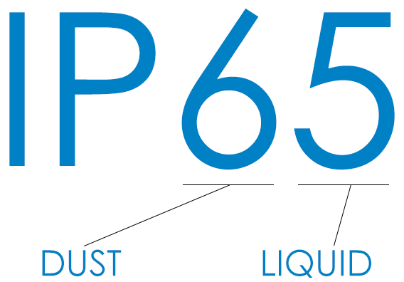
Understanding IP Ratings
Ingress Protection (IP) ratings are standards for the degree of protection an electrical enclosure provides for users from internal electronics and for the electrical components inside against the ingress of foreign objects and water.
IP ratings have two numbers with the higher the number the better protection:
  The first digit in the rating indicates the enclosure's ability to protect against the ingress of foreign solid objects, such as dust.
  The second digit indicates the level of protection against the ingress of water or other liquids.

Slide 21
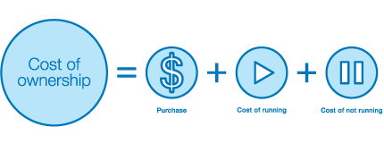
Maintenance and TCO
As we all know, there is no such thing as a display that is truly maintenance free. In short, we cannot “set it and forget it!” as a famous pitch man proclaims.
There is the need to monitor the condition of the display to insure proper performance.
There is the need to clean it, check connections, and calibrate the display not to mention any physical issue that might need to be addressed.
Maintenance is a significant part of total cost of ownership and is a recurring expense.
By selecting the correct display for the application you can insure that TCO is kept under control.
Nowhere is this more evident than with outdoor applications.

Slide 22
Outdoor / Semi- Outdoor LFD

Slide 23
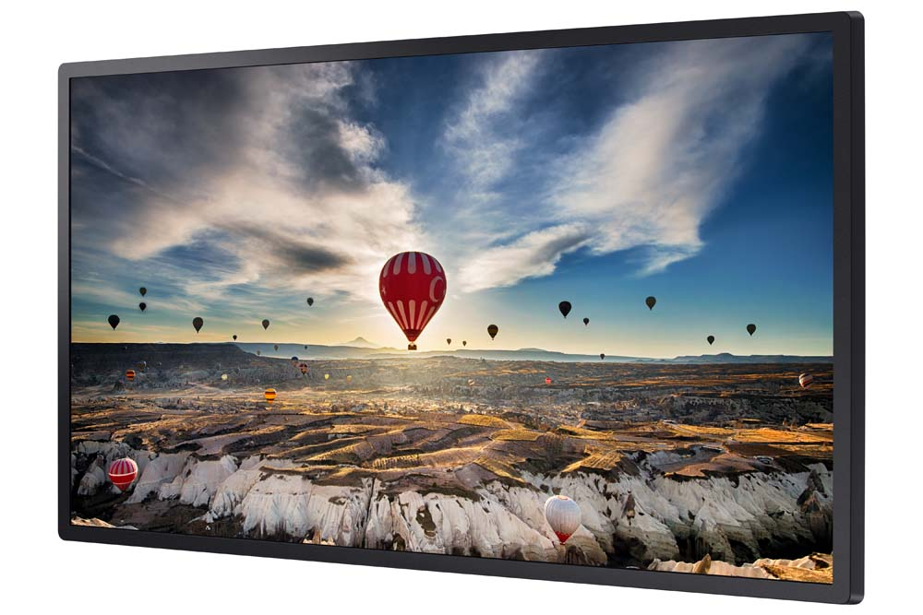

OMH Series
OM32H (32”)
High brightness LFD for non-IP rated applications (including videowalls), dealing with high ambient light.
Example Applications:
Brightly lit atriums
Well lit lobbies
Retail store windows
Key Features:
1920x1080 Full HD resolution
1000 nit 16/7 direct lit LED LFD
14mm bezel width
SSSP 4.0 / S4 Player (SoC) onboard
Not outdoor IP rated, intended for indoor sunlight use
Notes:
Additional Specs:
Gloss screen surface (0% haze)
Polarized for sunglasses use
2.1” chassis depth
NO SPEAKERS
NO TUNER
DisplayPort (1), HDMI (2), HDBaseT inputs
Videowall processor up to 15x15
Videowall loop through (DisplayPort) up 10x10 in 1080P with HDCP support (up to 7)
RS232 and IR loop through
Full RS232 and IP control
Ethernet networking
3-year onsite commercial warranty

Slide 24
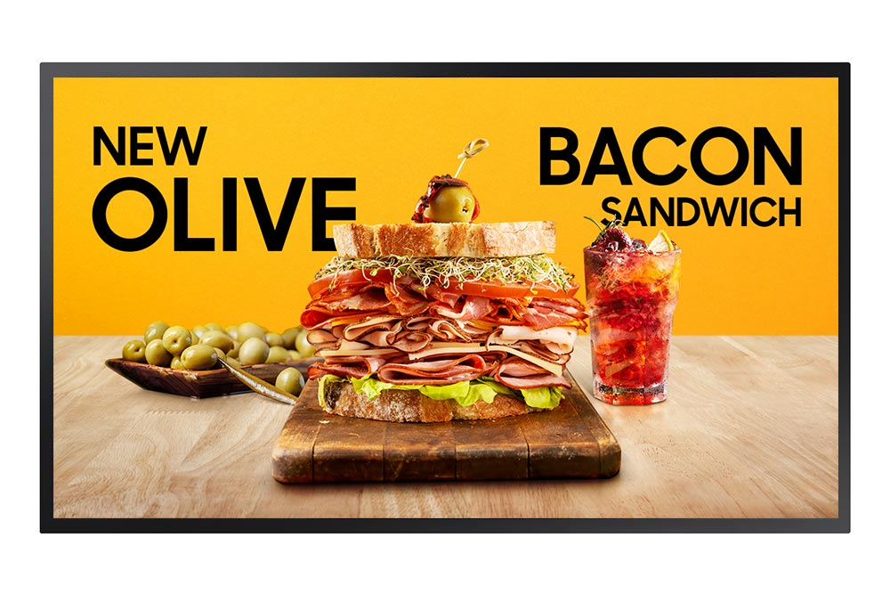
OMN Series
OM46N (46”), OM55N (55”)
High brightness LFD for non-IP rated applications (including videowalls), dealing with high ambient light.
Example Applications:
Brightly lit atriums
Well lit lobbies
Retail store windows
Key Features:
1920x1080 Full HD resolution
4000 nit 24/7 edge lit LED LFD
19.9mm bezel width
SSSP 6.0 / S6 Player (SoC) onboard with Tizen 4.0
Wi-Fi onboard
IP5X rated against dust
Not outdoor IP rated, intended for indoor sunlight use
Notes:
Additional Specs:
Gloss screen surface (0% haze)
Polarized for sunglasses use
2.1” chassis depth
NO SPEAKERS
NO TUNER
Videowall processor up to 15x15
Videowall loop through (HDMI) up 10x10 in 1080P with HDCP support (up to 7)
RS232 and IR loop through
Full RS232 and IP control
Ethernet and wireless networking
3-year onsite commercial warranty

Slide 25
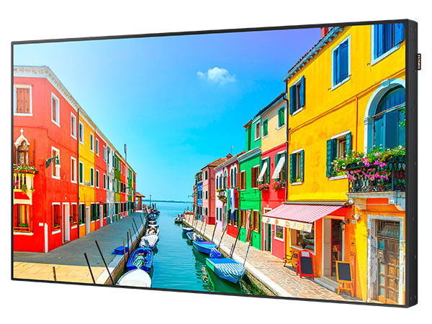
OMD-W Series
OM75D-W (75”)
High brightness LFD for non-IP rated applications (including videowalls), dealing with high ambient light.
Example Applications:
Brightly lit atriums
Well lit lobbies
Retail store windows
Key Features:
1920x1080 Full HD resolution
2500 nit 24/7 direct lit LED LFD
11.7mm bezel width
SSSP 2.0 / S2 Player (SoC) onboard
Wi-Fi onboard
Not outdoor IP rated, intended for indoor sunlight use
Notes:
Additional Specs:
Gloss screen surface (0% haze)
Polarized for sunglasses use
5” chassis depth
Built in speakers
NO TUNER
Videowall processor up to 15x15
Videowall loop through (DisplayPort) up 10x10 in 1080P with HDCP support (up to 7)
RS232 and IR loop through
Full RS232 and IP control
Wi-Fi and Ethernet networking
3-year onsite commercial warranty

Slide 26
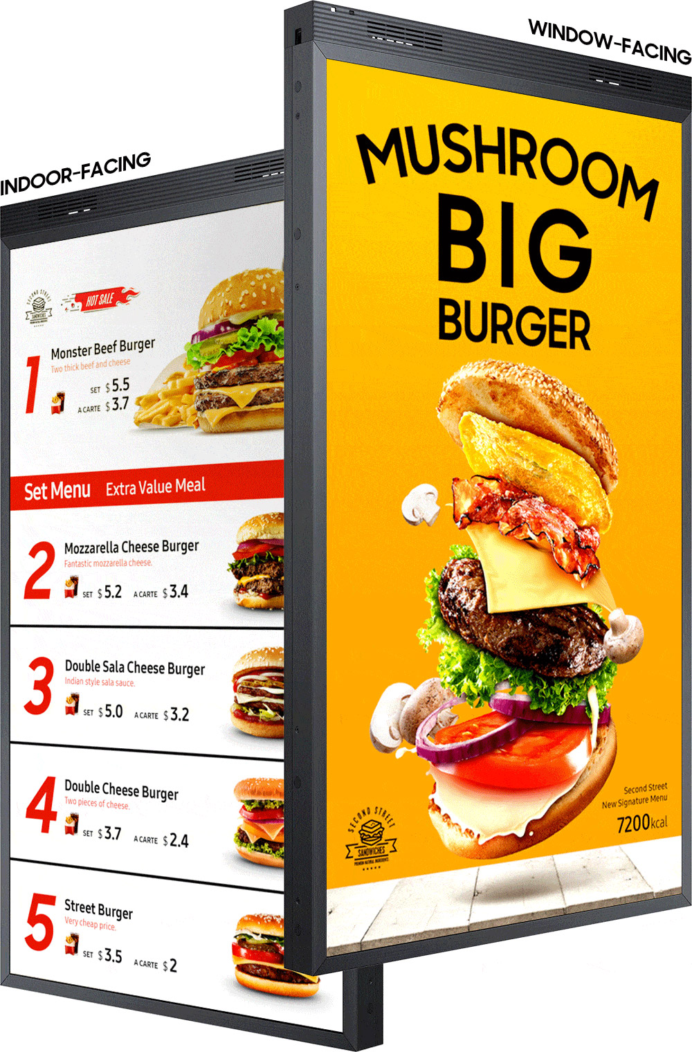
OMN-D Series
OM46N-D (46”), OM55N-D (55”)
High brightness DUAL SIDED LFD for non-IP rated applications, dealing with high ambient light.
Example Applications:
Brightly lit atriums
Well lit lobbies
Retail store windows
Key Features:
PORTRAIT ONLY
1920x1080 Full HD resolution
3000 nit (front) / 1000 nit (back) 24/7 edge lit LED LFD
22.8mm bezel width
SSSP 6.0 / S6 Player (SoC) onboard with Tizen 4.0
Wi-Fi onboard
IP5X rated against dust
Not IP rated, intended for indoor sunlight use
Notes:
Additional Specs:
Gloss screen surface (0% haze)
Polarized for sunglasses use
2.7” chassis depth
NO SPEAKERS
NO TUNER
HDMI (2) inputs
SEPARATE INPUTS AND SOC PER SIDE
Wi-Fi and Ethernet networking
Full RS232 and IP control
3-year onsite commercial warranty
SBB module support

Slide 27
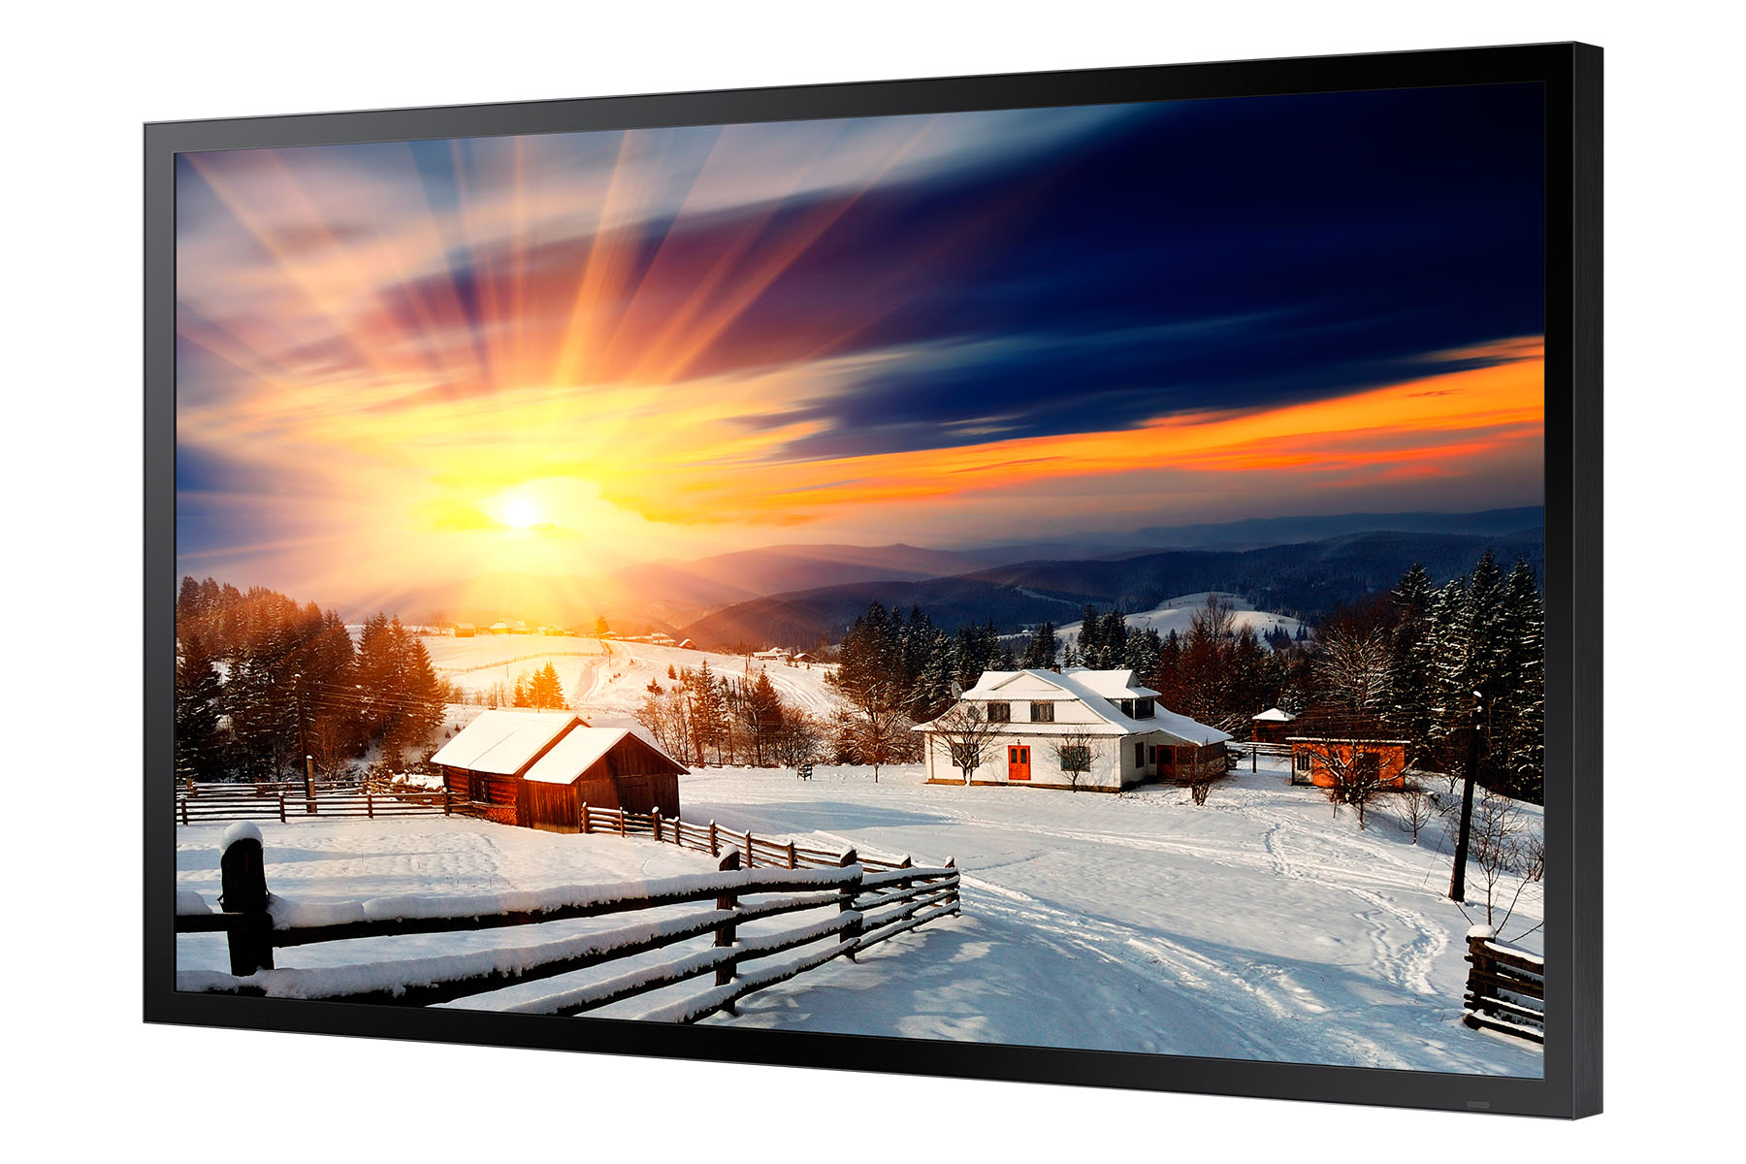
OHF Series
OH46F (46”), OH55F (55”), OH75F (75”), OH85F (85”)
Fully enclosed, IP rated high brightness LFD for applications dealing with high ambient light, that does not require a separate enclosure.
Example Applications:
Wayfinding outdoors
Digital signage for theme parks / sports venues / garages
Train / subway stations
Key Features:
1920x1080 Full HD resolution (85” 4K UHD)
2500 nit 24/7 direct lit LED LFD
24.9mm (75” 59.8mm , 85” 62mm) bezel width
SSSP 4.0 / S4 Player (SoC) onboard
IP56 rated
Tempered armor glass front for impact resistance
Notes:
Additional Specs
Gloss screen surface (protective glass)
3.35” chassis depth (75” and 85” 4.72”)
NO SPEAKERS
NO TUNER
HDMI 1.4 (2) HDBaseT, 85” DP 1.2 (2)
Ethernet networking
NO WI-FI ONBOARD
Full RS232 and IP control
3-year onsite commercial warranty

Slide 28
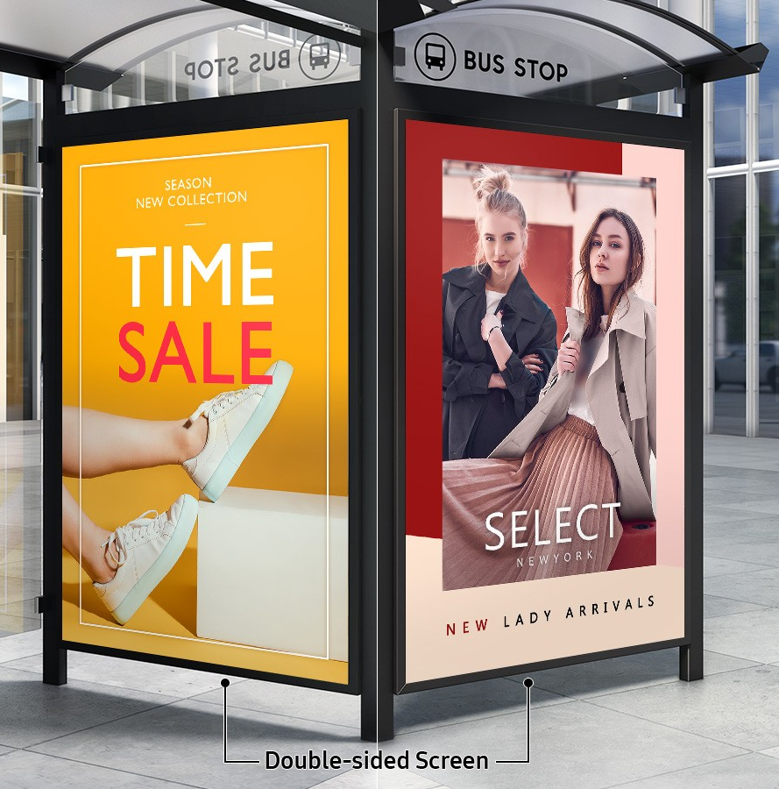
OHN-D Series
OH85N-D (85”)
Fully enclosed, IP rated high brightness DUAL SIDED LFD for applications dealing with high ambient light, that does not require a separate enclosure.
Example Applications:
Wayfinding outdoors
Digital signage for theme parks / sports venues / garages
Train / subway stations
Key Features:
3840x2160 4K UHD resolution
3300 nit 24/7 direct lit LED LFD
62mm bezel width
SSSP 6.0 / S6 Player (SoC) onboard with Tizen 4.0
IP56 rated
Tempered armor glass front for impact resistance
Notes:
Additional Specs
Gloss screen surface (protective glass)
9” chassis depth
NO SPEAKERS
NO TUNER
HDMI 2.0 (4), DP 1.2 (2)
Ethernet networking
NO WI-FI ONBOARD
Full RS232 and IP control
3-year onsite commercial warranty

Slide 29
For more information, contact your local Samsung representative, or Brawn Consulting:
1 (866) 754-6450
samsunglfd@brawnconsulting.com
Jonathan Brawn
Principal
Brawn Consulting
E: jonathan@brawnconsulting.com
Brian Kosich
Engineering Services Manager
Brawn Consulting
E: brian@brawnconsulting.com
Thanks for Attending!

