Slide 1
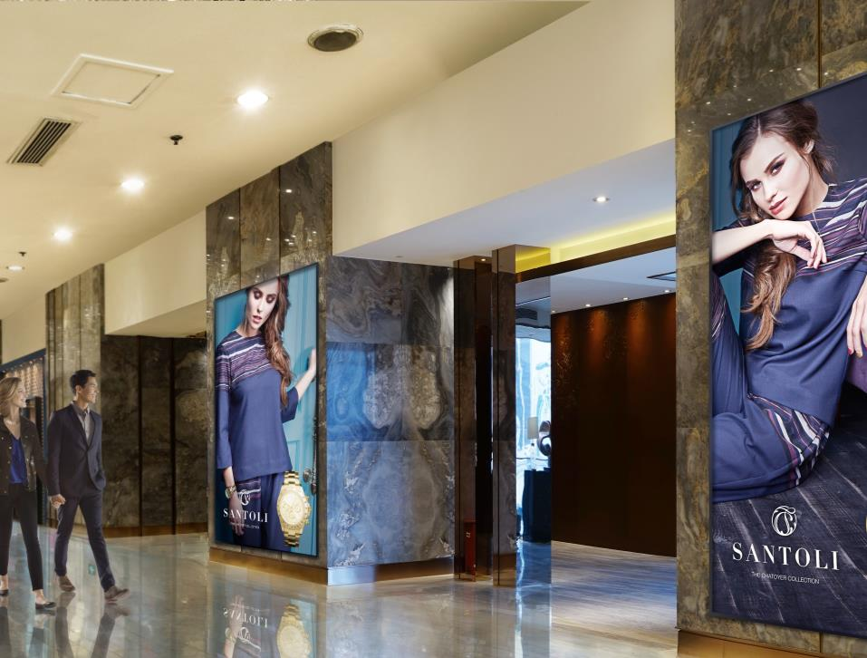
Understanding Direct View LED Display Technology

Slide 2
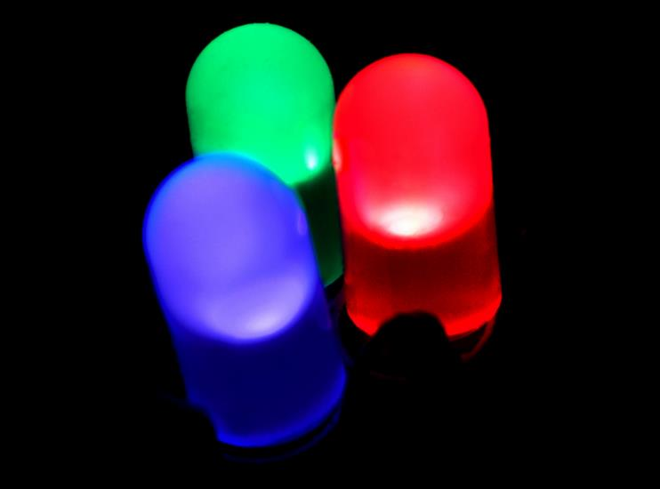
Shedding Light on the LED
When those of us in the commercial AV industry think of a display, we automatically think of a projector or flat panel.
However, over the last few years, we have seen an explosion of what was considered a fringe technology into the mainstream.
This technology has brought vivid, full motion seamless displays that were impossible with traditional AV technologies directly into our daily lives.
Just what is that technology you ask? The answer is the direct view LED, in both indoor and outdoor applications.
To understand direct view LED displays, we will explore the history of LEDs, how they operate, and specifications that are important in selecting a direct view LED display.

Slide 3
The History of the LED

Slide 4

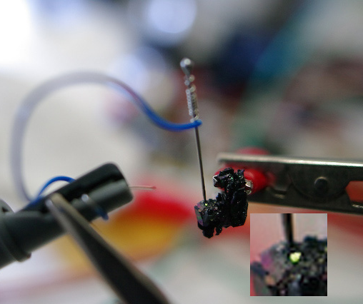
Discovery of the LED
The History of the LED
The phenomenon of electroluminescence discovered in 1907 by Henry Joseph Round.
British experiments in the 1950s led to the first "modern” red LED, which appeared in the early 1960s.
By the mid 1970's LEDs could produce a pale green light. LEDs using dual chips (one in red and one in green) were able to emit yellow light.

Slide 5
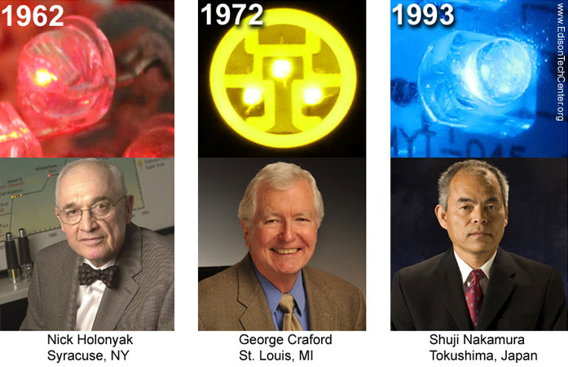
Development of the Modern LED
The History of the LED
The early 1980s brought the first generation of super bright LEDs, first in red, then yellow and finally green, with orange-red, orange, yellow and green appearing in the 1990’s.
The first significant blue LEDs also appeared at the start of the 1990's, and high intensity blue and green in the mid 1990’s.
The ultra bright blue chips became the basis of white LEDs, in which the light emitting chip is coated with fluorescent phosphors.
This same technique has been used to produce virtually any color of visible light and today there are LEDs on the market which can produce previously "exotic" colors, such as aqua and pink.

Slide 6
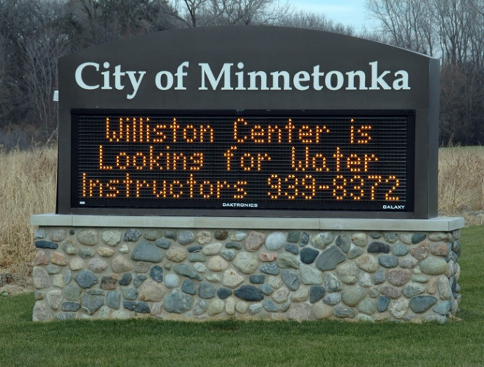

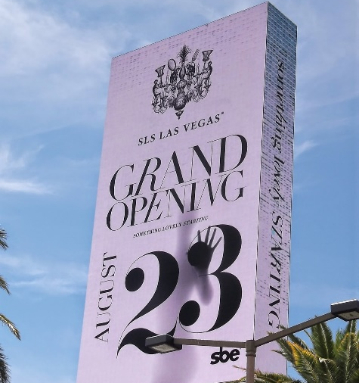
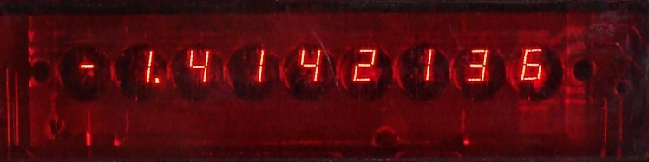
Direct View LED Display Evolution
The first LED display:
TI-30 Calculator

Slide 7
LED Construction and Operation

Slide 8
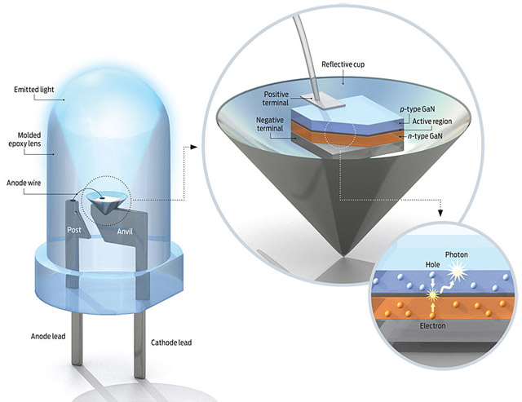
Light Emitting Diode (LED)

Slide 9
LED Construction
Light emitting diodes (LEDs) are source of continuous light with a high efficiency.
At the heart of a light emitting diode is a semiconductor chip, containing several very thin layers of material that are sequentially deposited onto a supporting substrate.
The first semiconductor material that is deposited onto the substrate is doped with atoms containing excess electrons, and a second doped material, containing atoms having too few electrons, is then deposited onto the first semiconductor to form the diode. The region created between the doped semiconductor materials is known as the active layer.
When a voltage is applied to the diode, holes (positive charges) and electrons (negative charges) meet in the active layer to produce light.

Slide 10
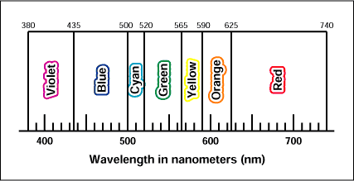
LED Construction
The wavelength of light emitted by the diode is dependent upon the chemical composition and relative energy levels of the doped semiconductor materials and can be varied to produce a wide range of wavelengths.
After being fabricated, the chip is mounted in a reflector cup connected to a lead frame and is bonded with wire to the anode and cathode terminals.
The entire assembly is then encased in a solid epoxy dome lens that enables emitted light to be focused, controlled by embedding tiny glass particles into the lens that scatter light and spread the light beam, or angled, via changing the shape of the lens, or the reflector cup.

Slide 11
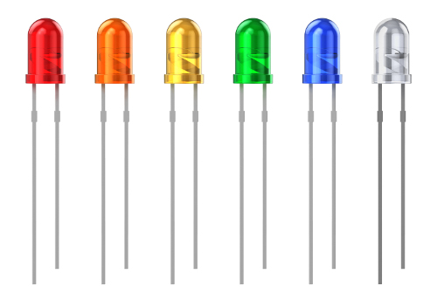
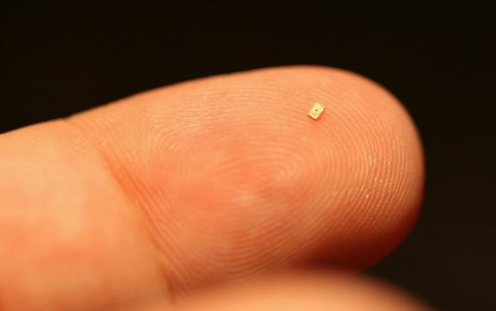
Types of LED
Discrete Diode
  Discrete diodes are the rounded individual “bulbs” we commonly think of when considering an LED. They are fully separate components meant to be installed in a variety of ways, encased in an epoxy dome.
SMD (Surface Mount Device) Diode
  SMD Diodes are flat, miniaturized packages meant to be installed onto a circuit board. They are often very small and can be placed in areas with less space or requiring higher density of components.

Slide 12
dvLED Display
Construction and Specifications

Slide 13
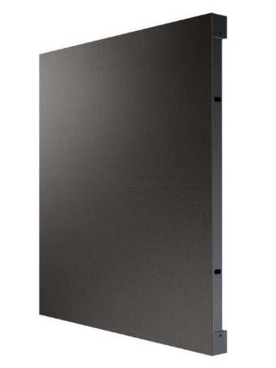
dvLED Display Construction
Direct view LED (dvLED) displays are made up of individual pixels, like any other display device.
Each pixel is constructed from a cluster of red, green, and blue LEDs.
These pixels are arranged into larger panels and combined into cabinets.
LED displays may be more expensive per square foot of display area than other technologies due to manufacturing; LED displays require a lot of assembly from individual components.

Slide 14
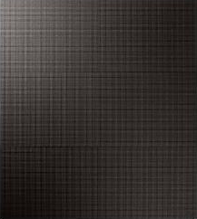
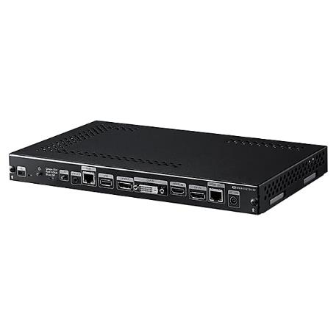
dvLED Display Construction
One or more LED cabinets are connected for data and power.
One or more processors connect to each group of LED cabinets. Multiple outputs can be used to create displays of any size or shape.
Control software configures the wall and adjusts the input source to fit.

Slide 15
dvLED Display Pixel Pitch
One of the key specifications for an LED display is pixel pitch. This metric defines how “coarse” or “fine” the image will be, and thus how close a viewer can stand to the display before the image appears pixilated.
Pixel pitch is defined as the distance between two pixels. The distance is measured from the center of one pixel to the center of the next pixel.
Pitch determines the amount of empty space between the pixels.
Pixel Pitch
Coarse Pixel Pitch
Fine Pixel Pitch

Slide 16
dvLED Display Resolution
LED displays, like traditional flat panels and projectors, have a resolution. This resolution is dependent on the matrix area, or size of the display.
The resolution of an LED display is the number of pixels in it, generally described in terms of width times height, like any other display.
Because of the relatively fixed size of a pixel, larger displays will have a higher resolution they can display. However, this is also dependent on pixel pitch.
A display with a smaller pixel pitch will have a higher resolution than a same sized one with a larger pixel pitch, because you can fit more of the pixels into the same physical space.
20MM Pixel Pitch
10MM Pixel Pitch
300 Pixels
600 Pixels
500 Pixels
1000 Pixels

Slide 17
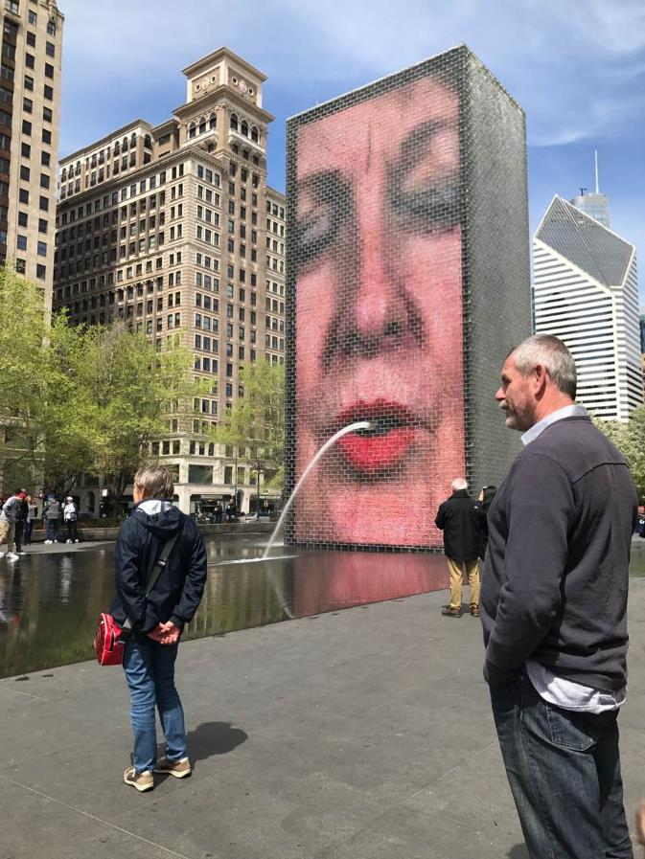
dvLED Display Brightness
Direct View LED display brightness (like an LCD) is measured using CD/M² (candelas per meter squared, also known as nits).
Nits describe how much light is being emitted by the display.
Where LCD displays are typically measured in the hundreds of nits (350-700 nits are typical), direct view LED displays can compete with direct sunlight, and thus can produce upwards of 9,000 nits.
For typical indoor applications, a direct view LED display could be 1500 nits or less. This will not overwhelm viewers with an image that is too bright for the environment.
Where direct sunlight is on the direct view LED display (indoors or outdoors), at least 1,500 nits is called for - but 3,000 or more would make the image appear much higher quality and more saturated.

Slide 18

Types of Direct View LED Displays
There are two types of led cabinets: conventional, using discrete diode LEDs, and surface mounted device (SMD) modules.
Most outdoor displays are based around discrete diodes, as they can be weatherproofed and withstand more heat than SMD diodes.
Most indoor displays are built out of SMD diodes, allowing for a finer pixel pitch for closer viewing distances. These are difficult to weatherproof.

Slide 19
Advantages of dvLED

Slide 20
Why Use dvLED?
Advantages of dvLED
Size
  dvLED can scale to any size, unlike a standard flat panel or projector.
  dvLED provides a seamless image, without the bezels present in a videowall.
  dvLED can be customized to fit nearly any area.
Brightness
  dvLED can produce 9000 nits or more. This makes them much more visible in daylight.
  dvLED will not suffer from glare like flat panels will.
  dvLED is not impacted by ambient light, like a projector.
Contrast
  dvLED displays can produce superior contrast than all projectors and most flat panel technologies.
Color Saturation
  dvLED can produce deeper colors at higher brightness than all projectors and most flat panels.

Slide 21
Why Use dvLED?
Advantages of dvLED
Viewing Angle
  dvLED displays do not suffer from the same brightness fall off and color shift as some flat panels.
  dvLED can offer a wider viewing angle at higher brightness than most projectors.
Viewing Distance
  Both the brightness and size allow dvLED displays to be visible and legible from many times the distance of a traditional flat panel (hundreds of feet).
Maintenance
  Flat panels will require frequent cleaning of the surface glass to maintain image quality.
  Solid state construction allows for a much more durable screen surface than flat panel glass.
  dvLED lasts much longer than a single projector lamp or hybrid projector engine.
  dvLED typically has small replaceable modules, instead of replacing an entire LCD panel.

Slide 22
dvLED Design Considerations

Slide 23
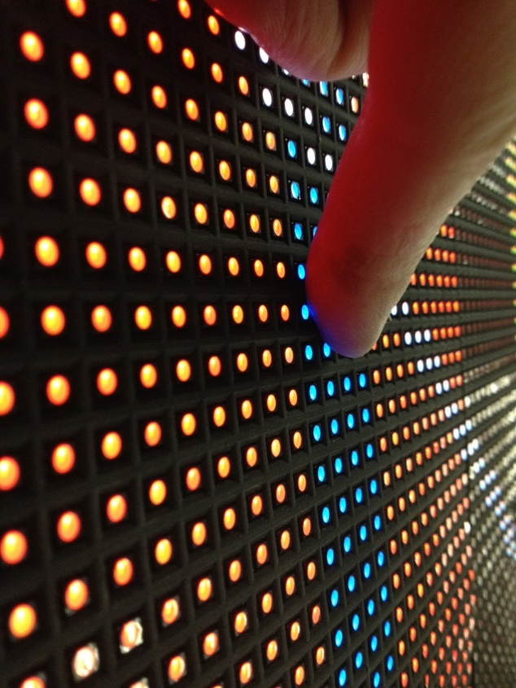
Pixel Pitch VS. Viewing Distance
The pixel pitch of a dvLED display not only defines the quality of the image, but also defines how close someone should stand to the display before they will see the individual pixels.
This is based on human visual acuity, that is the ability of the eye to resolve a small object as separate and distinct.

Slide 24

Pixel Pitch VS. Viewing Distance
1.5MM
7-8 ft
10-11 ft
Minimum
Recommended
1.8MM
9-10 ft
12-13 ft
Minimum
Recommended
2.5MM
12-13 ft
17-18 ft
Minimum
Recommended
4MM
20-23 ft
28-30 ft
Minimum
Recommended
6MM
30-32 ft
40-45 ft
Minimum
Recommended
A good rule for specifying viewing distance VS. pixel pitch:
  Minimum (you won’t see a gap between pixels, but the image might still appear grainy) is 5x pitch.
  Recommended (the image should appear smooth) is 7x pitch

Slide 25
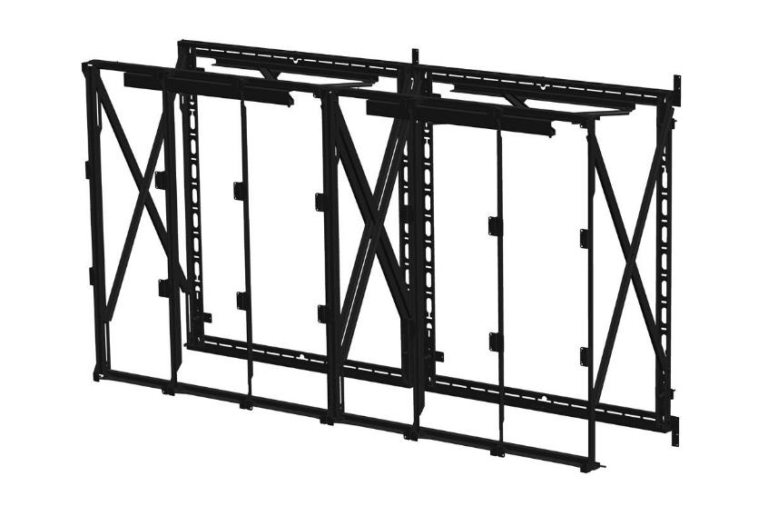
Mounting Requirements
Dealing with mounting dvLED panels can be complex.
A dvLED can weigh significantly more than a flat panel videowall, and thus the wall structure must be capable of supporting it. Reinforcement may be required. Due to the higher weight, always use quality mounts and hardware.
Each LED manufacturer will have a unique tile size and mounting hole pattern, so it’s not nearly as simple as selecting a flat panel mount! In many cases, you may need customized mounting structures to fit the application.
For flat wall mounts, we are now seeing mounting solutions providers beginning to release standardized mounting systems for dvLED cabinets, like mounting a flat panel.
These mounts typically will support a segment of the overall LED wall, and are tiled not unlike a flat panel implementation.
Example: Premier FSXA Mount

Slide 26
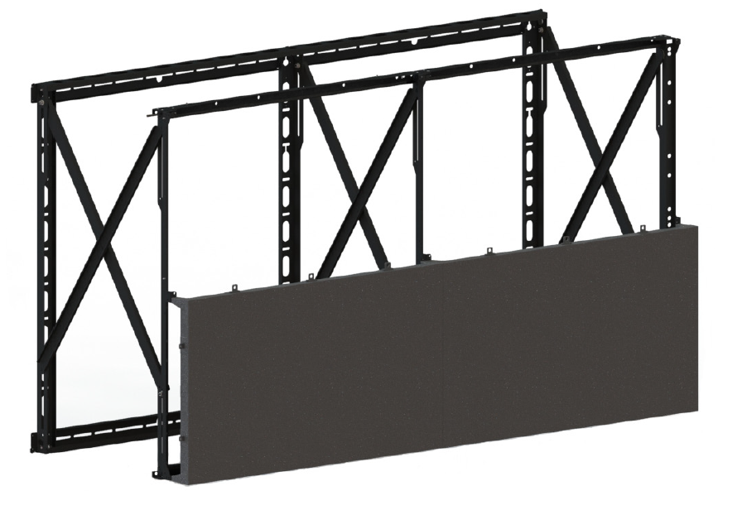
Mounting Requirements
Mount spacing is critical.
Trying to “eyeball” mounting is near impossible, and a recipe for disaster (and a very long and frustrating installation) that will never result in a quality alignment between tiles, which can leave gaps between cabinets.
Mounting structure should always allow for alignment adjustment between cabinet groups.
Some dvLED products are front serviceable, and will not need rear access, but not all have this capability. Always verify and design accordingly!

Slide 27
Discussing dvLED
with Your Customer

Slide 28
Starting the Discussion…
One of the hardest parts of selling dvLED is having the discussion with your customer.
  Is dvLED the right technology for their application?
  Will dvLED fit their requirements?
  How do we specify the right dvLED product?
Always keep this in mind – dvLED is not LFD or projection.
They will not be completely equivalent for some time.
So we need to qualify what type of technology is appropriate to recommend, and provide talking points to use with your customers.

Slide 29
dvLED Discussion Questions
Budget? LED is more expensive than LFD and projection.
Viewing Distance? How far away will the audience be?
Brightness? How much ambient light is in the space?
Image Quality? Are there concerns with contrast, color saturation, and viewing angle?
Bezels? Will having the grid of bezels be objectionable?
Resolution? If the viewing distance is close, what is the use case? Do they need high resolution for viewing minute detail?
From there, that will guide you to either dvLED or traditional displays. dvLED is lower resolution, more expensive, but seamless and brighter. LFD or projection will be higher resolution, but lower brightness, and has bezels (for LFD).

Slide 30
Samsung LED Products

Slide 31
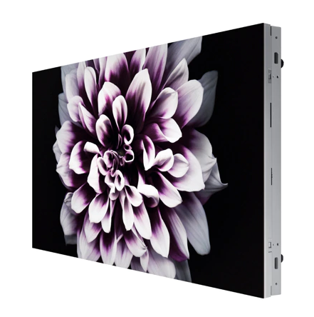
The Wall
IW008J (0.8mm)
Indoor Micro LED direct view display
1,600 nit (peak) / 500 nit (max) brightness
4K UHD:146” diagonal (4x4 configuration)
8K UHD: 292” diagonal (8x8 configuration)
Dimensions 31.8” W x 17.9” T x 2.8” D
Trim kits available

Slide 32
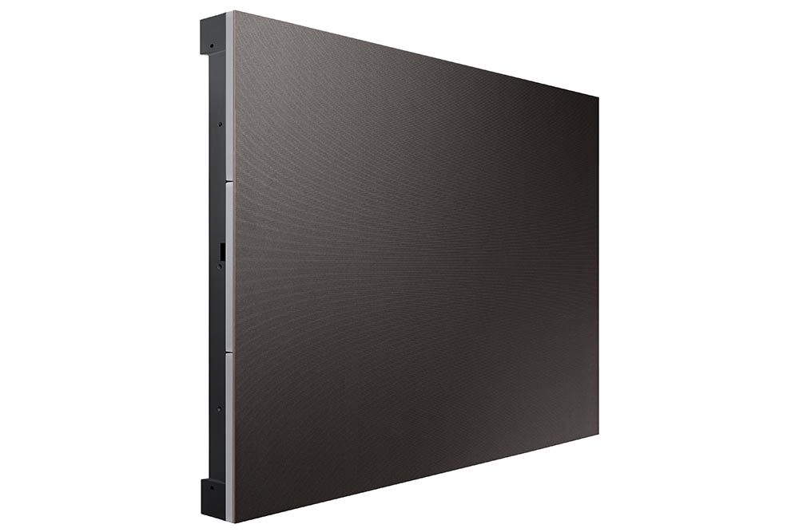
IFJ Series
IF012J (1.2mm)
1,200 nit (peak) / 600 nit (max) indoor direct view LED cabinet
Dimensions: 36.4” W x 17.9” T x 3.1” D
1.2mm FHD: 110” (3x3 configuration)

Slide 33
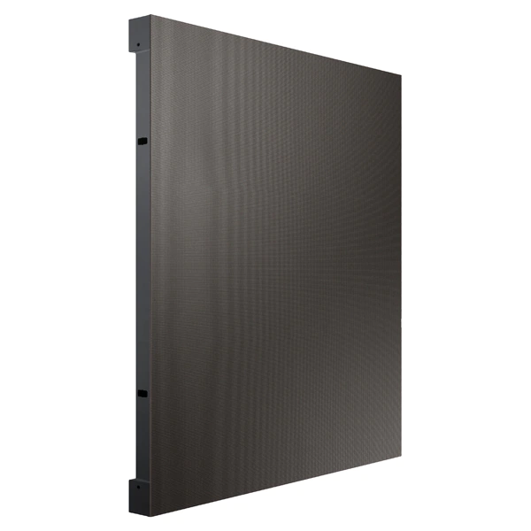
IFH Series
IF015H (1.5mm), IF020H (2.0mm), IF025H (2.5mm)
1,200 nit indoor direct view LED cabinet
Dimensions: 18.9” W x 21.3” T x 2.6” D
1.5mm FHD: 130” (6x3 configuration)
2.0mm FHD: 174” (8x4 configuration)
2.5mm FHD: 217” (10x5 configuration)

Slide 34
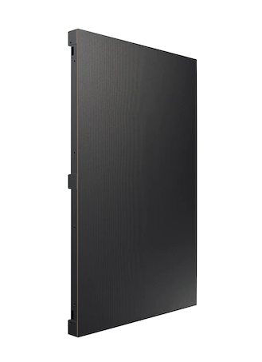
IFH-D Series
IF025H-D (2.5mm), IF040H-D (4.0mm), IF060H-D (6.0mm), IF088H-D (8.8mm)
1,800 nits (peak) / 1,200 nits (max) indoor direct view LED cabinet
Dimensions: 18.9” W x 34” T x 2.6” D
Can be installed inclined or hung from the ceiling
Able to install in both convex and concave curved configurations

Slide 35
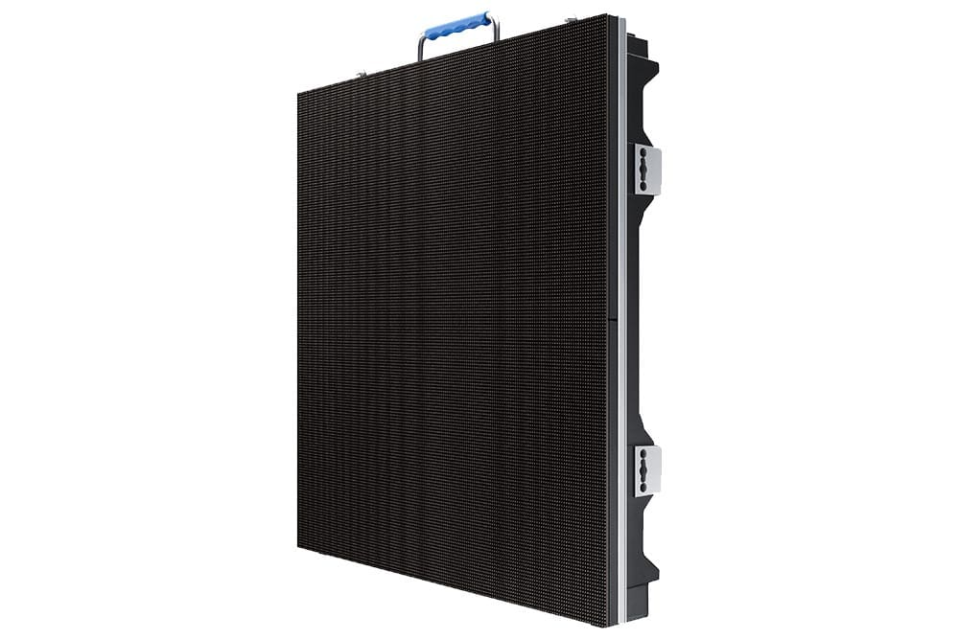
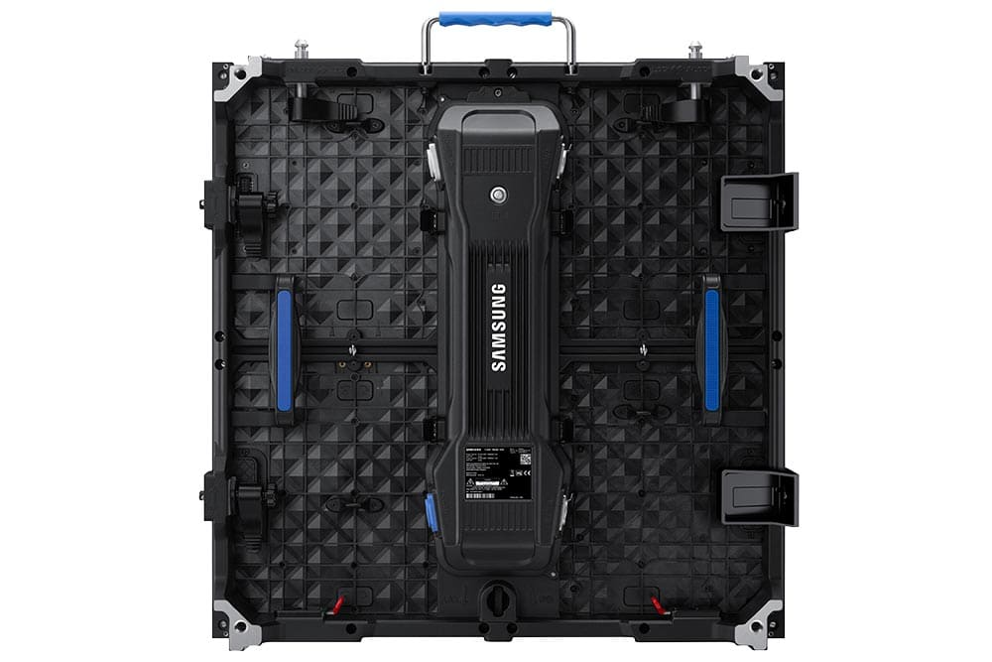
VMR Series
VMR-I Indoor: VM026R-I (2.6mm), VM029R-I (2.9mm), VM039R-I (3.9mm)
1,000 nit indoor direct view LED cabinet
Rental and staging style interlocking design
VMR-O Outdoor: VM029R-O (2.9mm), VM039R-O (3.9mm)
4,500 nit IP rated outdoor direct view LED cabinet
IP65 rated front and back
Operation temperature: -20 ~ 50 °C
Rental and staging style interlocking design

Slide 36
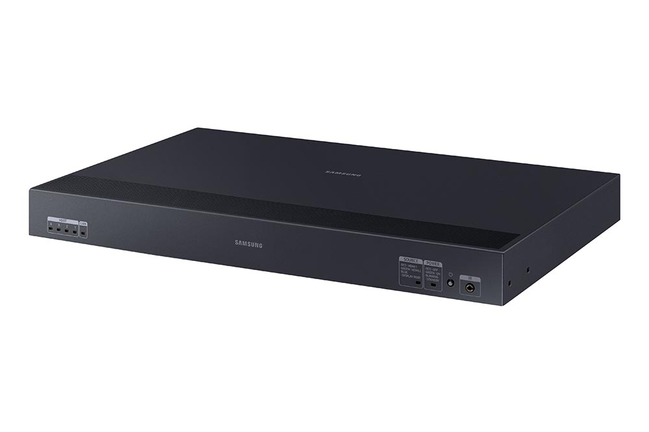
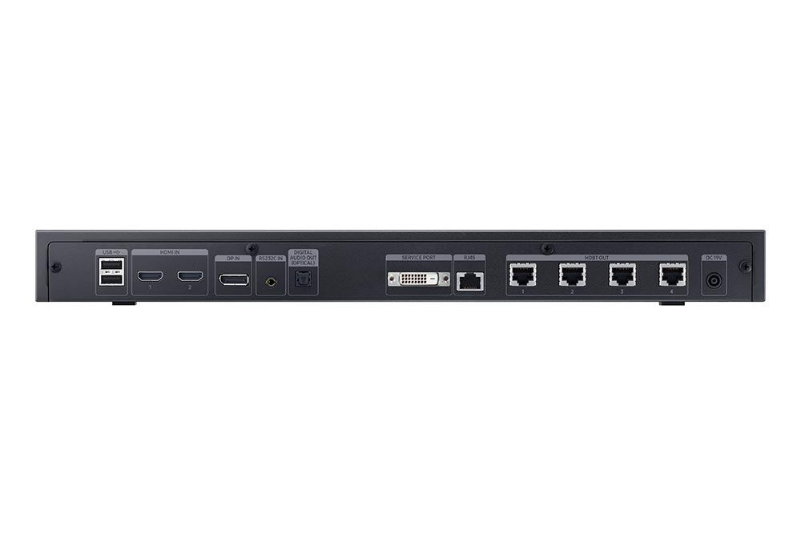
S-Box (Processor)
SNOW-1810U (SBB-SNOWJAU)
Can drive up to UHD (3840 x 2160) resolution per S-Box
Includes 4 I/G cards (user supplies CAT5 cable to connect I/G card to S-Box)
Tizen: 2.4 OS
LED HDR (Inverse Tone Mapping, Dynamic Peaking, Color Mapping), HDR10/10+,
DRE (Dynamic Range Expansion), Low Latency (for Live Mode), Dimming (for Semi Indoor)
Dimensions: 17.3” W x 10.7” D x 1.8” T

Slide 37
For more information, contact your local Samsung representative, or Brawn Consulting:
1 (866) 754-6450
samsunglfd@brawnconsulting.com
Jonathan Brawn
Principal
Brawn Consulting
E: jonathan@brawnconsulting.com
Brian Kosich
Engineering Services Manager
Brawn Consulting
E: brian@brawnconsulting.com
Thanks for Attending!

