Slide 1
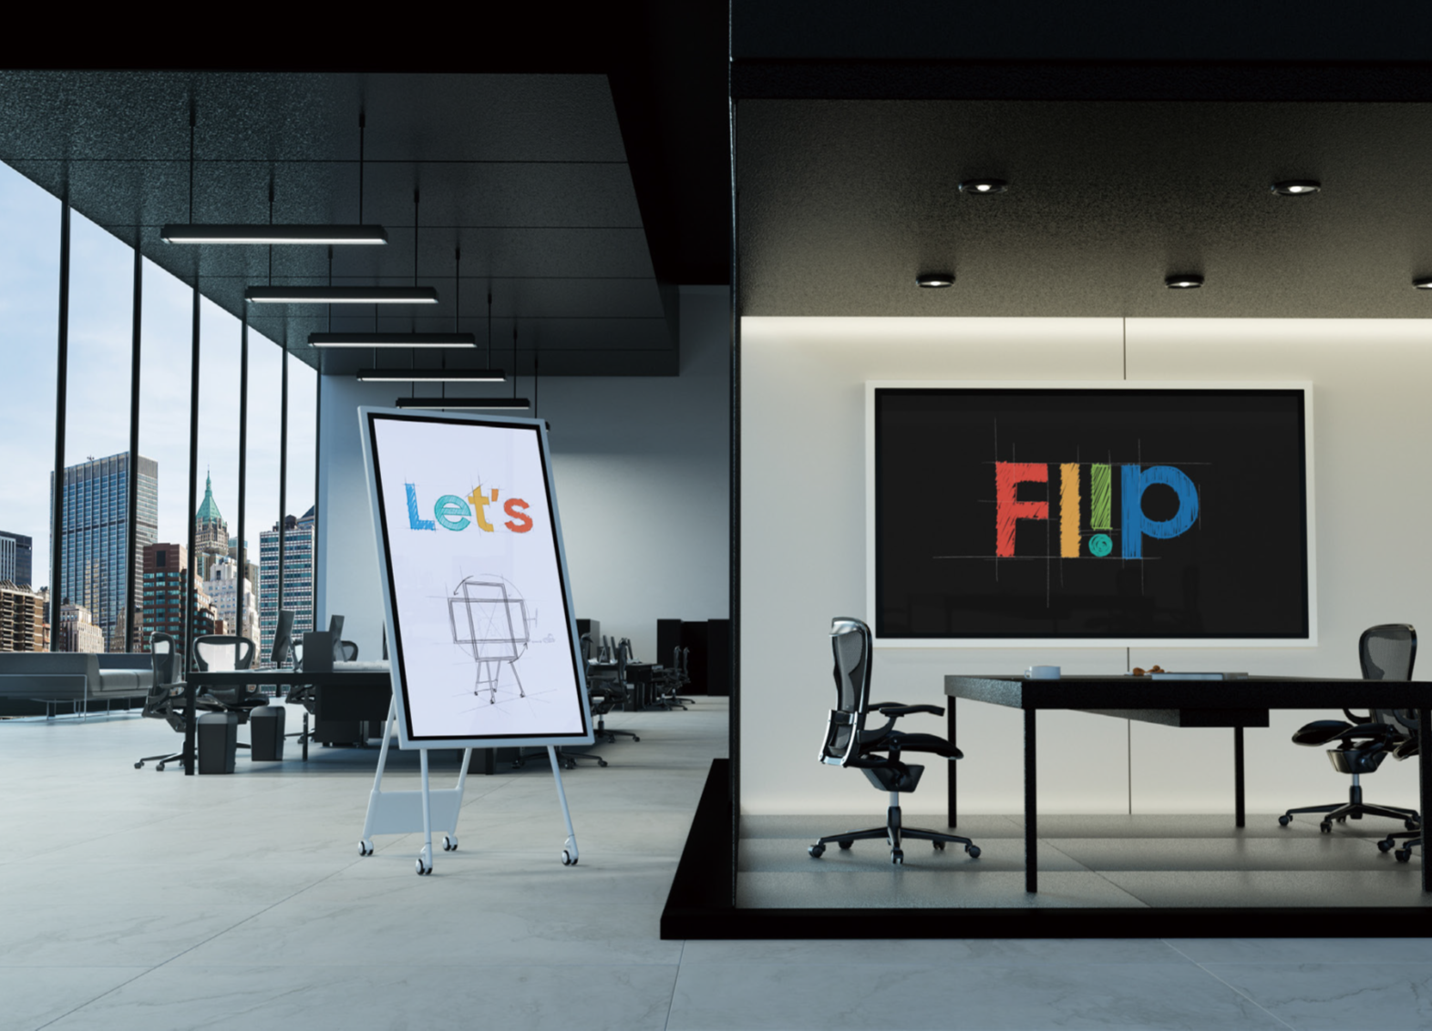
Samsung All-in-One Collaboration Solutions
Q4 2019

Slide 2
Samsung Provides Complete Solutions
Samsung has developed a complete line of turnkey commercial collaboration LFD (Large Format Display) solutions, reducing the number of suppliers needed for a project.
These LFDs include:
  Integrated multi-touch
  Embedded whiteboarding capabilities
  Enhanced collaboration capabilities
All of these are supplied by Samsung, with a single point of technical and warranty support.

Slide 3
e-Board LFDs
QBN-W Series

Slide 4
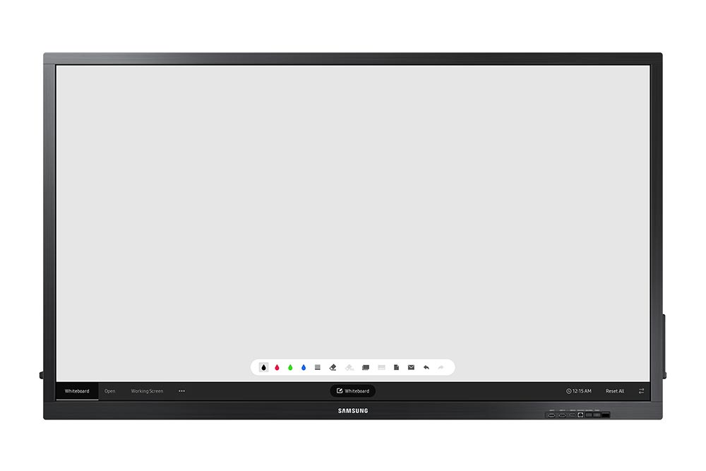

QBN-W Series
QB75N-W (75”)
Robust, all-in-one E-boards that feature enhanced touch technology and UHD picture quality
Key Features:
3840x2160 4K UHD resolution
300nit direct lit 16/7 LED display
Factory integrated IR touch
  10 point with external devices
  4 point with SoC
(SoC) onboard with Tizen 3.0, included MagicIWB S5 whiteboard software
Wi-Fi onboard with integrated Miracast screen mirroring
Front video and USB inputs
Includes passive pen
Notes:
Additional Specs
Matte screen surface (touch glass)
3.4“ chassis depth
Integrated speakers
2 HDMI 2.0 (rear) 1 HDMI 2.0 (front), DVI-D
USB out for touch overlay (1 rear 1 front)
Full RS232C and IP control
3-year onsite commercial warranty

Slide 5
e-Board LFD Features

Slide 6
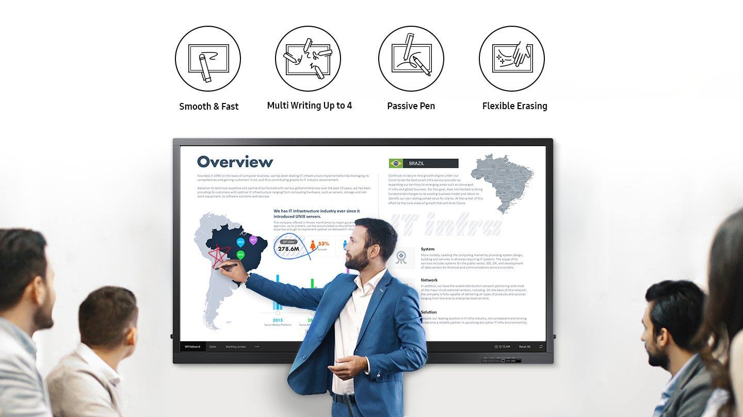
Enhance Touch, Enhance Capacity
Leverage heightened touch functionality for a smooth and versatile digital writing experience.
Up to 4 users can write simultaneously using the provided pen, or virtually any other tool.

Slide 7
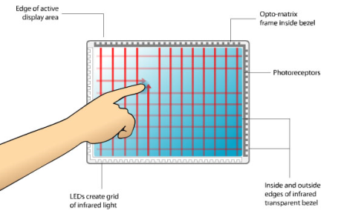
Infrared (IR) Touch Technology
Infrared (IR) touch systems use an array of infrared LEDs on two adjacent bezel edges of a display, with photo sensors placed on the two opposite bezel edges.
The infrared bezel is mounted to the front of the display screen where the LED and photo sensor pairs create a grid of light beams across the display.
An object (such as a finger or stylus) that touches the screen interrupts the light beams, causing a measured decrease in light at the corresponding photo sensors.
The measured photo sensor outputs can be used to locate a touch-point coordinate.

Slide 8
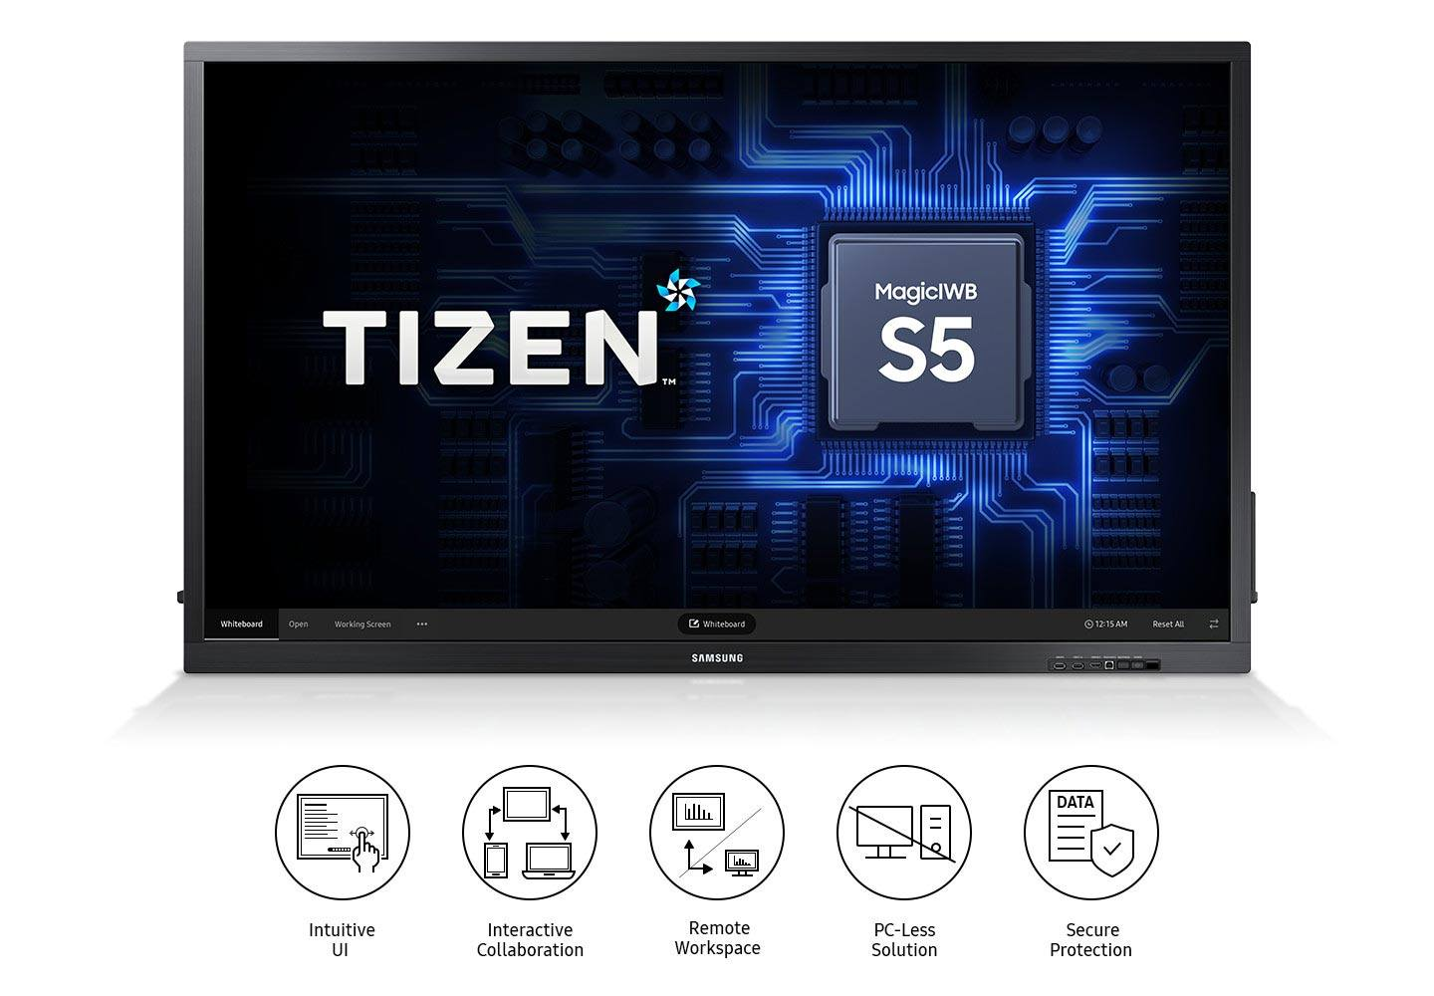
Elevate Collaboration Quality
The embedded MagicIWB S5 solution facilitates discussion management and organization with an intuitive interface for quick access to vital collaborative functionalities such as screen mirroring and real-time notation.

Slide 9
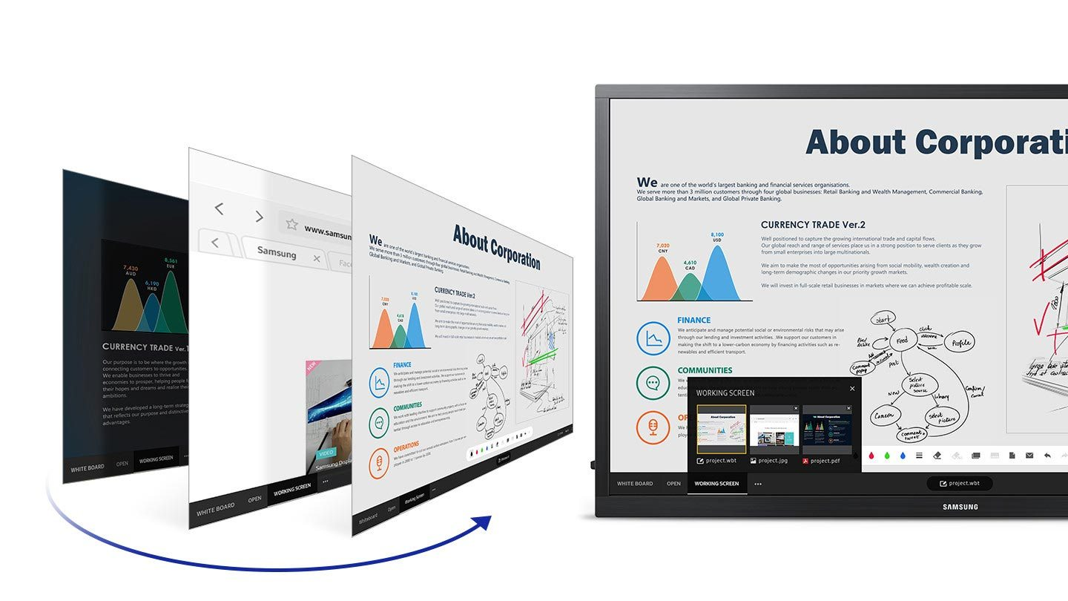
Switch Sources Seamlessly
Through the Working Screen function, users can quickly switch between multiple screens, such as the whiteboard, internet browser and connected input sources, with just a few touches.

Slide 10
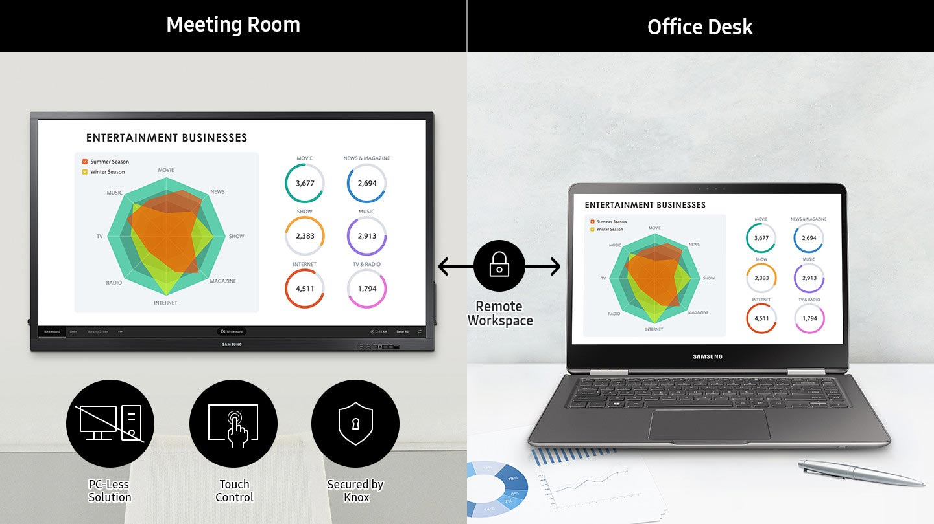
Retrieve and Control Content Remotely
Pull and edit content on remote laptops directly through the central screen utilizing touch functionality. The powerful Knox system secures the Remote Workspace connection to protect against information leakage and meddling.

Slide 11
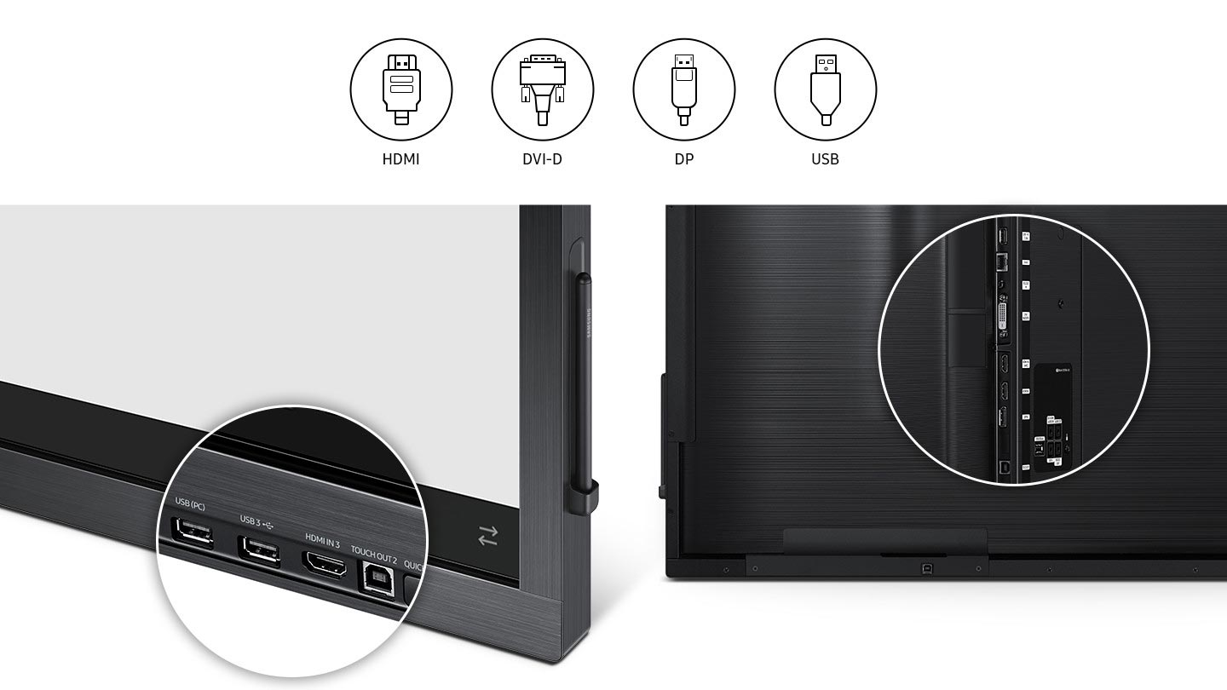
Connect with Convenience
Each e-board offers a wide range of connections including HDMI, DVI-D, DP and USB ports, where users can load, share and revise content directly from their personal devices.

Slide 12
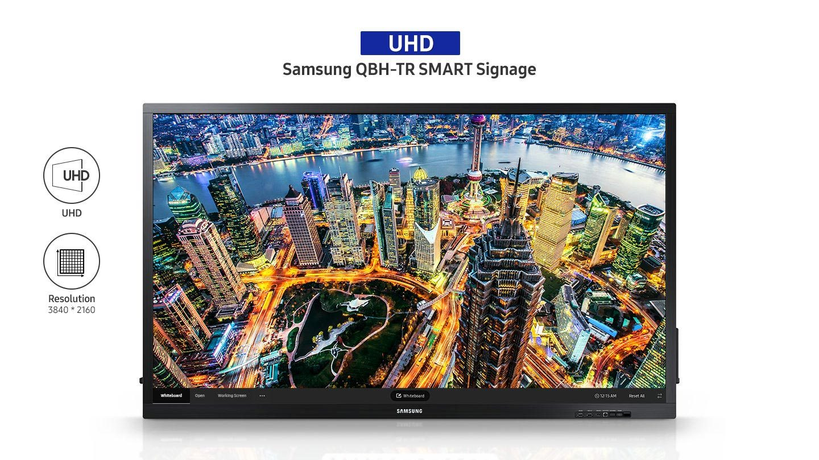
Amplify Visual Presentation
Bring collaborative ideas to life through advanced UHD picture quality. Through ultra-high resolution, ensure all notations and introduced content are clear and legible for every participant.

Slide 13
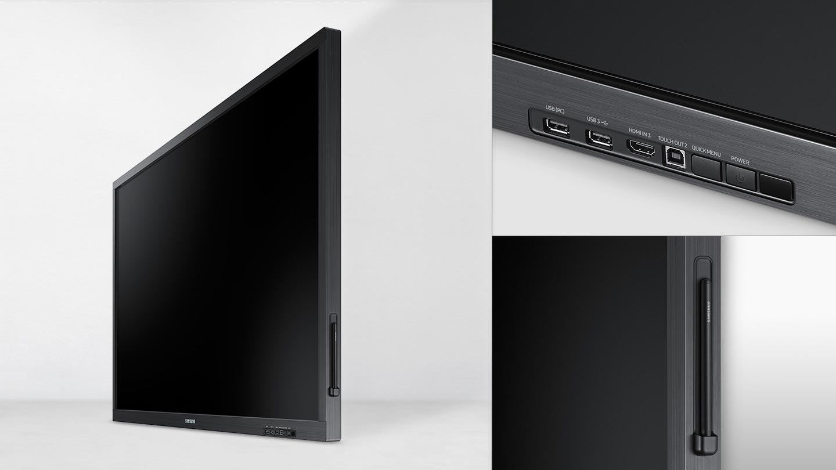
Maintain Organization with Style
Drive more organized collaboration with a sleek, sophisticated design. The magnetic side pen holder and frontal connection ports keep needed functions within reach, without the mess.

Slide 14
The Flip 2
WMR Series

Slide 15
Let’s Flip. Teamwork simplified.
Welcome to your best work life
Whether you’re solving your next big problem, brainstorming the next big idea or planning your next project, teamwork is key to reaching that next milestone. But today’s meeting environments present several digital barriers which can disrupt inspiring and engaging teamwork.
Introducing the Samsung Flip 2, an interactive display that simplifies teamwork without any hassle.
With the Flip 2, you can create freely thanks to a smooth pen-to-paper-like writing experience.
Ideas flow through smooth collaboration with an intuitive user interface. And with a host of convenient features, presenting is easier and more flexible than ever so you and your team can share insights and expertise from any source.

Slide 16
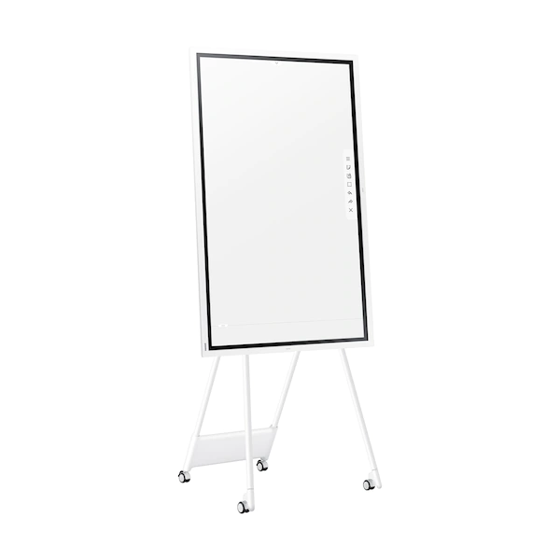
WMR Series
WM55R (55”)
An interactive digital flipchart designed for creative thinking, collaboration and innovation
Key Features:
3840x2160 4K UHD resolution
350nit edge lit 16/7 LED display
Factory integrated advanced IR 4-point touch
Included Flip 2 collaboration software
Full touch control
Wi-Fi with integrated Miracast screen mirroring (input and output)
Includes 2 passive pens
Input Tray: CY-TF65BRCXZA
Floor Stand: STN-WM55R
Notes:
Additional Specs
FTIR touch technology
Matte screen surface (touch glass)
Sensor for rotation
2” chassis depth
Integrated speakers
2 HDMI (rear), 1 USB (rear), 1 audio output (rear)
Input tray adds 3rd HDMI input, HDMI output, 2nd USB input, 2nd USB touch output, and USB upstream in/out. NFC pairing on tray
USB out for touch overlay (rear)
Wi-Fi and Ethernet networking
Limited IP control, no RS232
3-year onsite commercial warranty

Slide 17
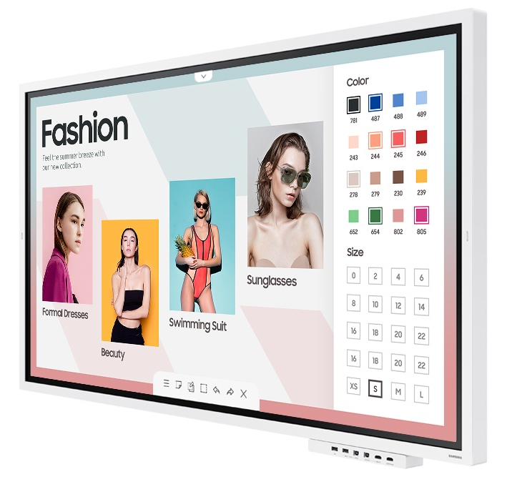
WMR Series
WM65R (65”)
An interactive digital flipchart designed for creative thinking, collaboration and innovation
Key Features:
3840x2160 4K UHD resolution
350nit edge lit 16/7 LED display
Factory integrated advanced IR 4-point touch
Included Flip 2 collaboration software
Full touch control
Wi-Fi with integrated Miracast screen mirroring (input and output)
Includes 2 passive pens
Input Tray: CY-TF65BRCXZA
Wall Mount: WMN-WM65RXZA
Notes:
Additional Specs
FTIR touch technology
Matte screen surface (touch glass)
Sensor for rotation
2” chassis depth
Integrated speakers
2 HDMI (rear), 1 USB (rear), 1 audio output (rear)
Input tray adds 3rd HDMI input, HDMI output, 2nd USB input, 2nd USB touch output, and USB upstream in/out. NFC pairing on tray
USB out for touch overlay (rear)
Wi-Fi and Ethernet networking
Limited IP control, no RS232
3-year onsite commercial warranty

Slide 18
Flip 2 Features

Slide 19
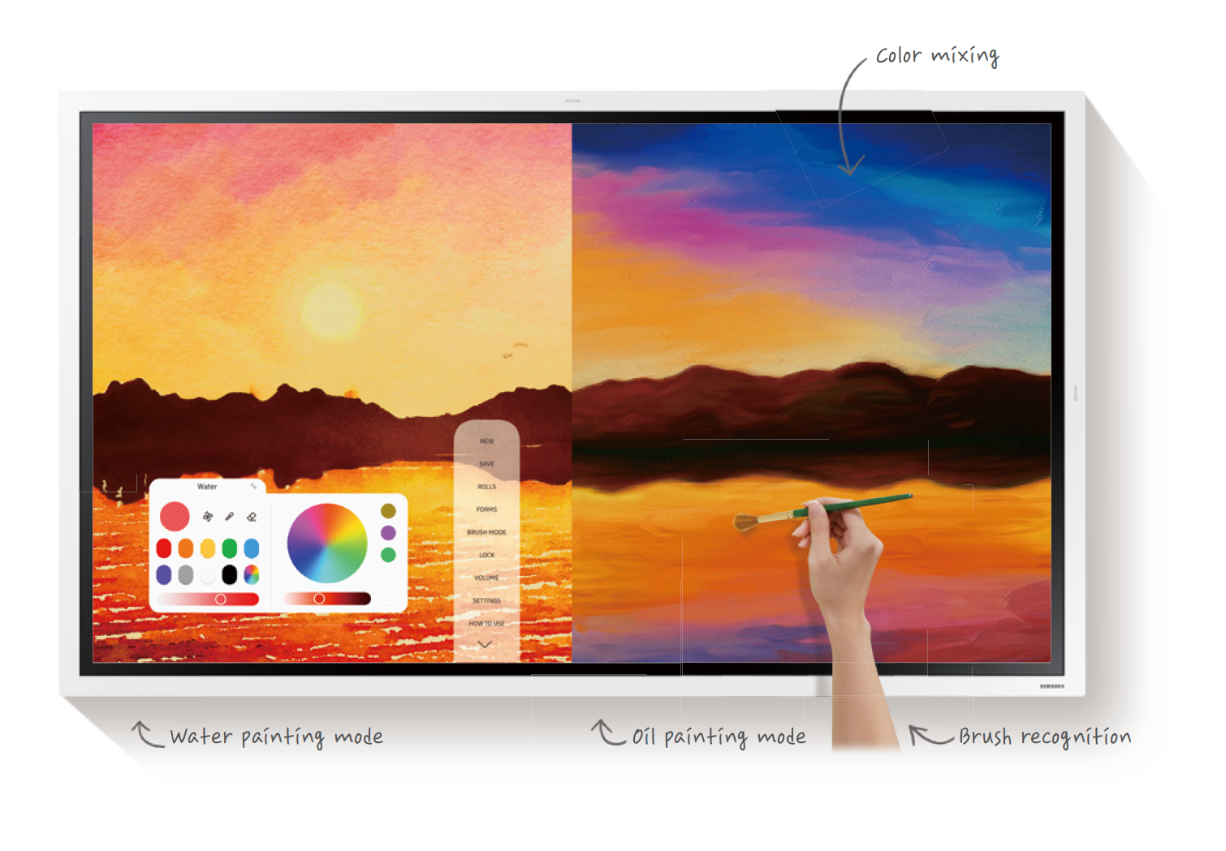
Create Freely
Samsung Flip allows you to enjoy a smooth, pen-to-paper-like writing experience, meaning you experience the next-generation digital flip chart like its real paper.
Simply edit your annotation with a finger or palm swipe motion.
Easily discover new ideas without using multiple sheets of paper.
Create art at the stroke of a brush in water as well as oil painting modes.
And for simultaneous interaction with your team members, up to four people can write at the same time on Flip screen.

Slide 20
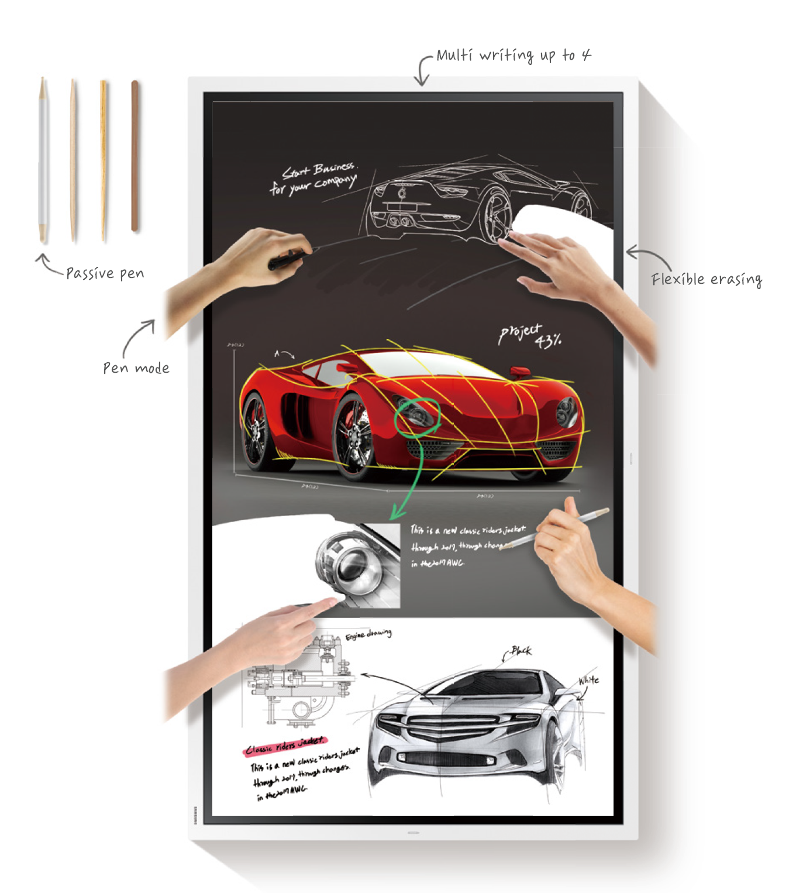
Create Freely
Pen mode
When in pen mode, the display provides smooth, fast writing in a variety of colors, styles and widths. Users don’t need to worry about having a certain type of pen either, with the ability to freely use any object as a writing tool.
Brush mode
Brush mode allows you to create art at the stroke of a brush with water and oil painting modes, which both allow different styles and textures. The Flip also gives users a full, vibrant color palette, even allowing flexible color mixing on the Flip roll. This provides enhanced re- alistic expressions, customized for water and oil modes. On water mode, you can adjust the settings for even more detailed artwork, and both modes have object thickness recognition, ensuring the Flip recognizes the pen regardless of the size of the brush tip.
Flexible erasing
Flexible erasing means that with just a simple finger or palm swipe motion, users can quickly and easily clear a small section of content, or the full screen.
Multi writing up to 4
Up to four different meeting participants can make notes at the same time using the embed- ded pen or virtually any writing tool.
InGlassTM technology
InGlass™ technology ensures real-time feedback and speeds without delay. This allows users to experience smooth writing or drawing, equivalent to that of working on traditional paper.

Slide 21
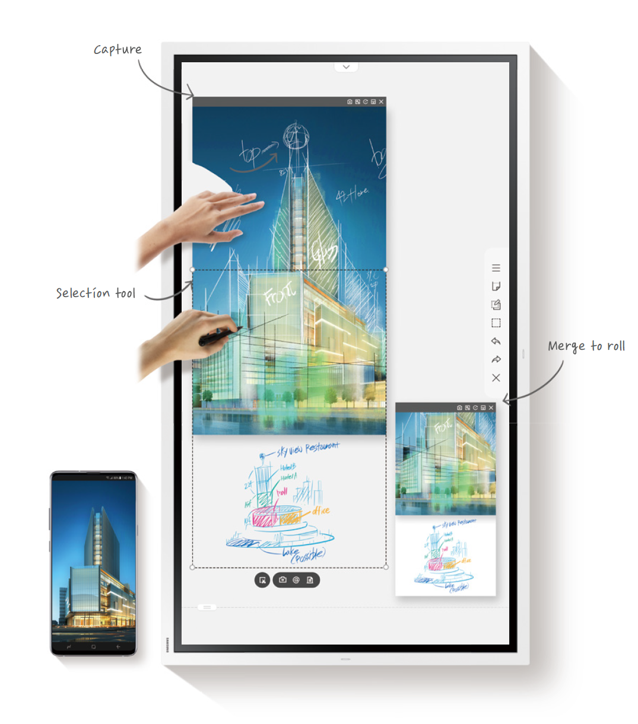
Collaborate Smoothly
Samsung Flip is a comprehensive solution, offering a variety of tools for creative and efficient collaboration. You and your team can directly edit images on the Flip roll at the simple click of a button. You can write on any background source with annotation layer to avoid affecting the original source. Scrolling through pages and navigating to any desired page is always smooth and quick for enhanced collaboration. And don’t forget to ensure all your hard work and ideas are kept safe with a password security system.

Slide 22
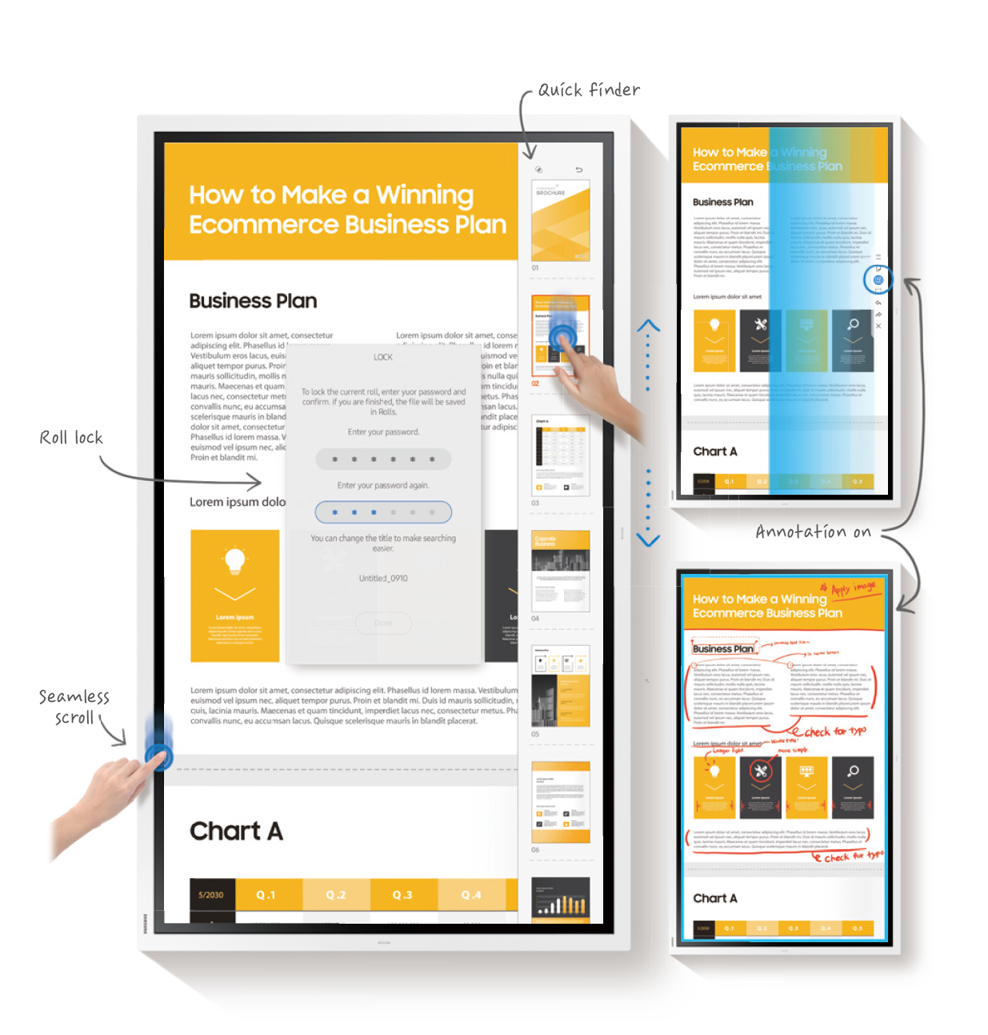
Collaborate Smoothly
Selection tool
Samsung Flip offers enhanced versatility, allowing users to quickly and easily select, crop, capture, move and edit any images on the Flip’s roll without any hassle.
Merge to roll
Images can also be merged to the roll with just one click of a button, allowing it to be edited or erased.
Annotation on
Samsung Flip allows users to write on any background source. By simply clicking the note layer button, users can enjoy smooth writing any time on any content displayed, without af- fecting work behind the original layer.
Seamless scroll
Samsung Flip allows users to stay well organized through clear page dividers, while providing the ability to quickly scroll through up to 20 pages at a time.
Quick ﬁnder
An intuitive, user-friendly menu simplifies navigation and reduces the time required to access controls or view content in its entirety. Facilitators also can preview individual content pages and make instant changes directly on the screen.
Roll lock
Ensure that your latest and greatest ideas remain in the right hands through a reinforced security system. Each in-office team can set a unique, numeric 6-digit password to lock the display and remove critical content from view.

Slide 23
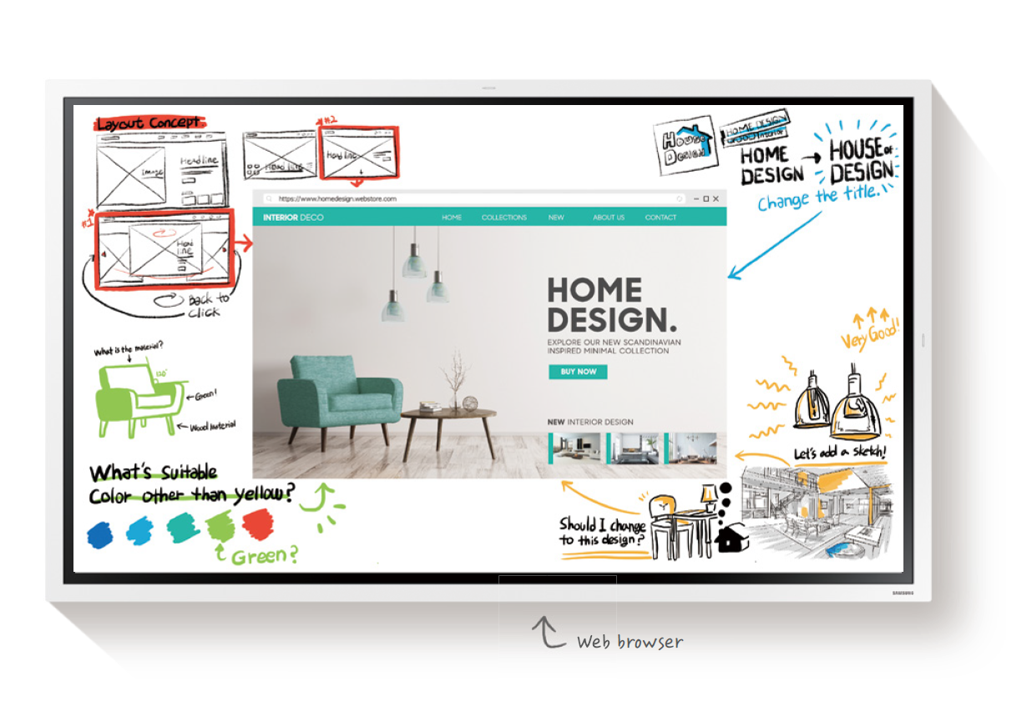
Present Effortlessly
Samsung Flip enables effortless presentation, supported by innovative features. You can access any web browser directly, various types of documents and cloud services, in addition to control via a PC with no physical connection needed. When not being used, the Flip can be used as a message board showing a preselected screensaver such as a company logo or menu board, while touch lock removes editing access for controlled content presentation. These are all reinforced with UHD picture quality and flexible pivot functionality for an enhanced visual experience.

Slide 24
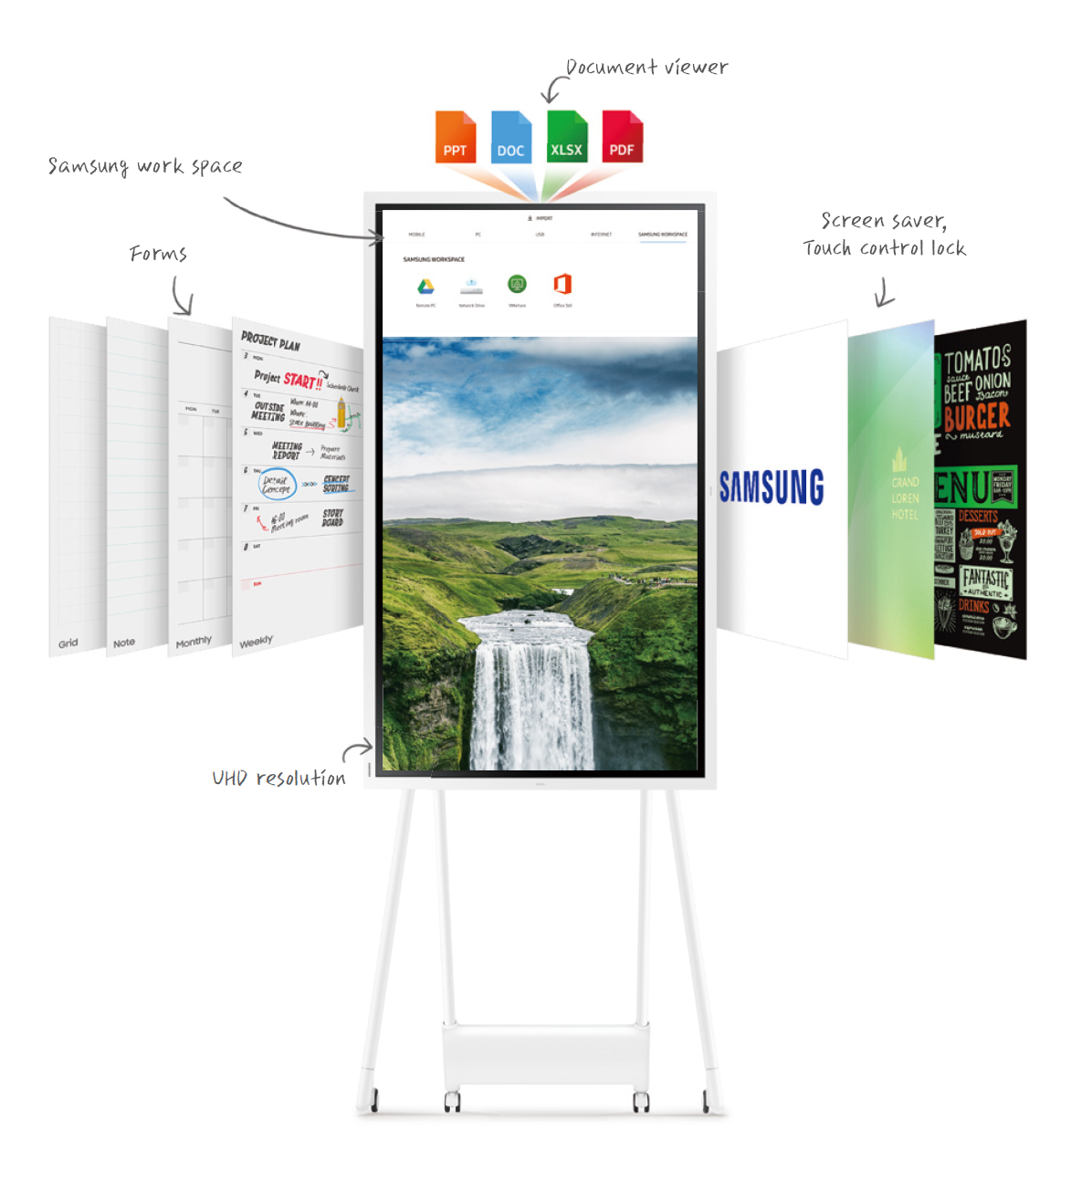
Present Effortlessly
Web browser
Samsung Flip offers direct access to any web browser and allows users to write new ideas besides the browser, even while video content is playing.
Forms
Samsung Flip can be used for a wide range of business applications, providing embedded versatile forms in both landscape and portrait mode. Users can use the Flip as a calendar, scheduler, note or checklist board, perfectly matching any business need.
Document viewer
Users can not only open images, but also documents such as Microsoft Word, PowerPoint and PDF, with a built-in document viewer. Once the selected document is open, users can then read, capture and take notes on them.
Samsung Workspace
With security provided by Knox, Samsung Workspace supports wireless cloud service access and control of a PC without needing a physical connection. The Samsung Flip allows users to connect their PC to the board remotely, meaning any meeting can be started without a PC to ensure efficiency. A Bluetooth keyboard and mouse can also be connected to the Flip, creat- ing a convenient meeting environment.
Screen saver
When in standby mode, the Flip can be tailored to include a company logo, menu board or preferred image. This allows companies to natively display important messages, updates and daily content.
Touch control lock
Users have the option to lock the screen, removing access for others to change the content presented on the screen. When the touch control lock is set, drawing and writing on the display are prohibited.
UHD resolution & Pivot
Regardless of annotation size or style, the Flip display maintains brilliant, eye-catching UHD picture quality. The Samsung Flip offers added flexibility for presentation in any desired format, such as portrait or landscape mode, thanks to convenient pivot functionality.

Slide 25
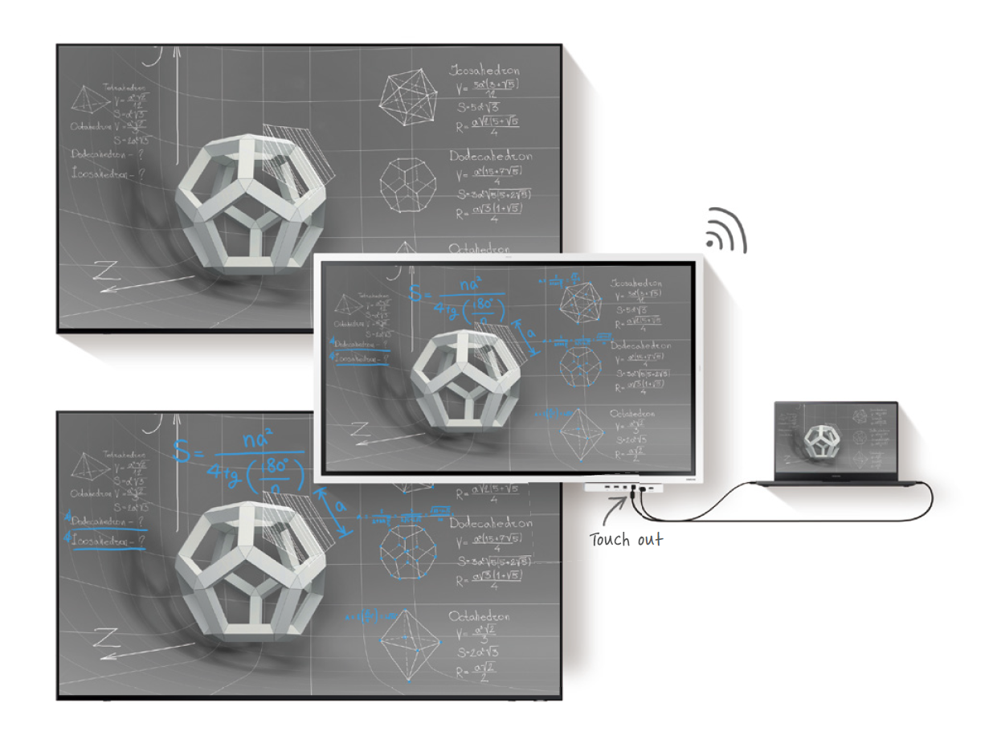
Share Easily
Samsung Flip enhances idea sharing for a variety of environments and audience sizes. Multiple connectivity options mean that you can share content by projecting on to another large display, or sync your personal devices using the touch out function, for real-time content sharing. Once the meeting is over, recaps can be distributed via the Flip without any hassle.
Screen share
Users can project content on the Samsung Flip directly to another large-sized digital display, using screen mir- roring or HDMI out connection. Users can also project the content on a personal device such as a note PC, using the Flip.
Touch out
The touch out functionality allows users to sync their personal devices with the Flip, offering real-time content sharing and control. Any changes made on the Flip dis- play will be mirrored on the connected device, and vice versa, for efficient collaboration.

Slide 26
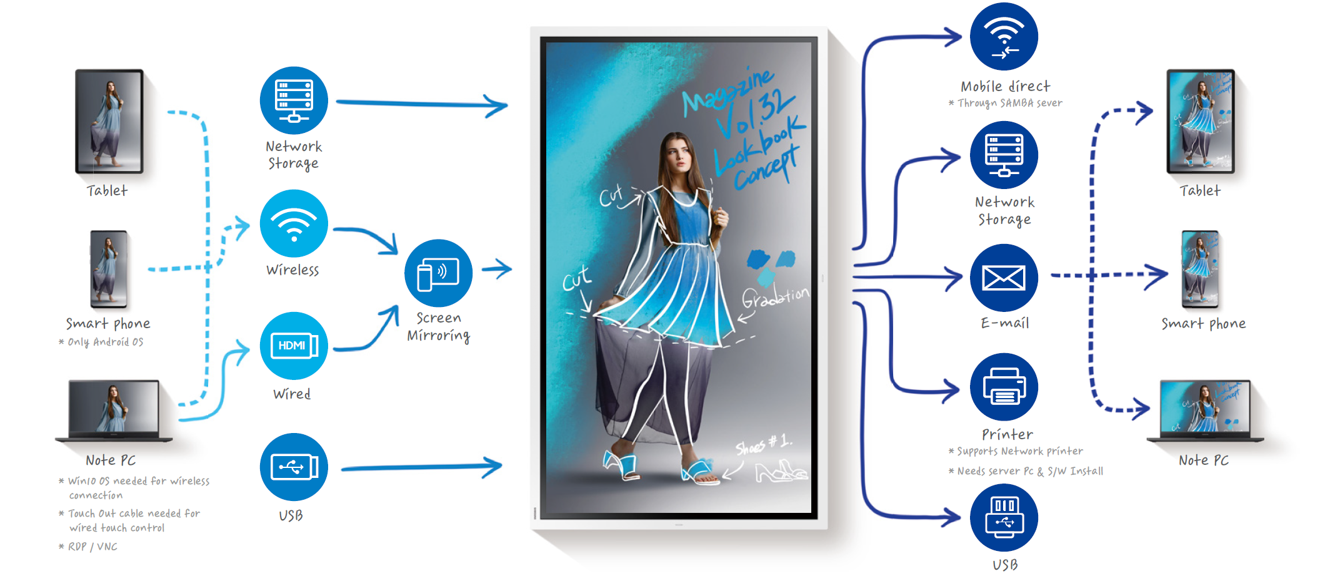
Share Easily
Versatile connectivity
Users are empowered by the Flip’s versatile connection options. USB, HDMI, NFC and screen mirroring capabilities provide interactive content visibility, notation and sharing. The Flip also offers an optional tray as a more powerful connectivity extension.
Easy sharing
Following any meeting, users can distribute recaps to all attendees and colleagues, removing the frustration tradi- tionally associated with handwritten meeting notes. Important conversations and content are stored within the Flip in real-time, easily shareable across mobile and digital channels.

Slide 27
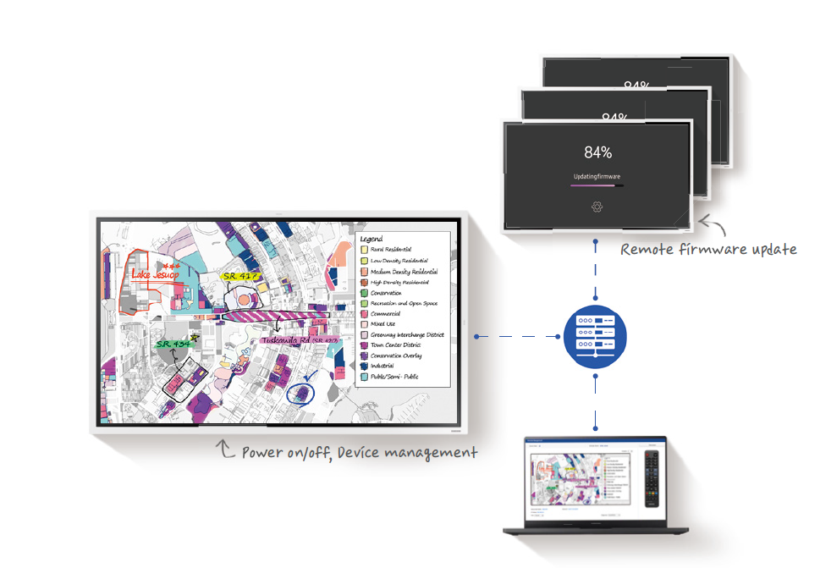
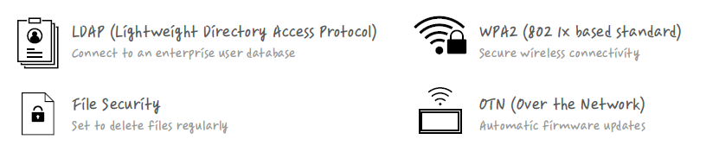
Complete Management
Samsung Flip offers improved management tools and security functions to ensure a convenient and productive meeting experience, even in large enterprises where technical constraints on infrastructure might be a factor. You can flexibly manage multiple Flip displays with the convenience of remote management.
Remote management
Remote management maintains remote monitoring features such as auto save, auto power off and the ability to adjust proxy server settings and delete files remotely. Additionally, Samsung Flip offers improved centralized management and security regardless of location with remote firmware updates, remote power on/off, and the ability to adjust security settings such as network security lock, USB lock and capture function lock.

Slide 28
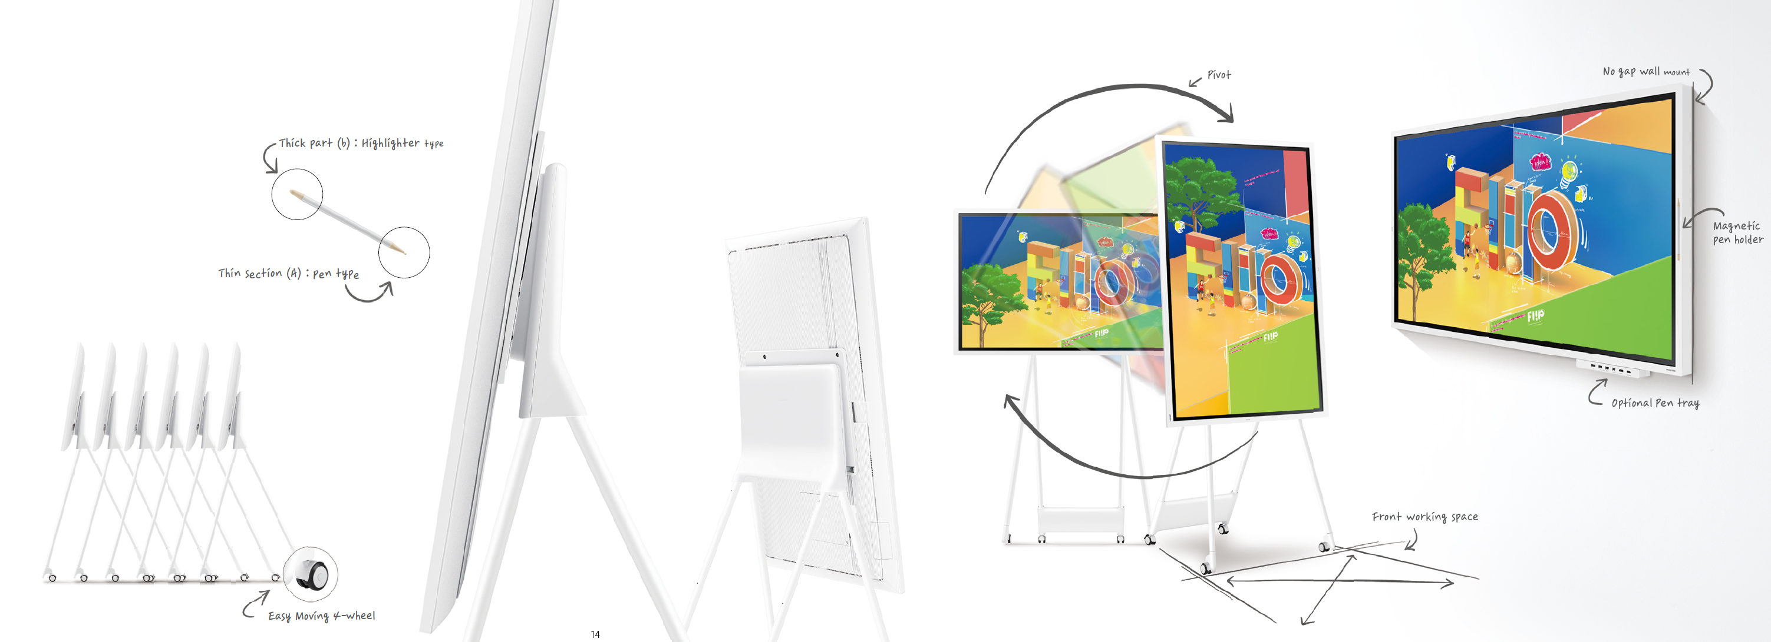
Easy to Use Anywhere

Slide 29
For more information, contact your local Samsung representative, or Brawn Consulting:
1 (866) 754-6450
samsunglfd@brawnconsulting.com
Jonathan Brawn
Principal
Brawn Consulting
E: jonathan@brawnconsulting.com
Brian Kosich
Engineering Services Manager
Brawn Consulting
E: brian@brawnconsulting.com
Thanks for Attending!

