Slide 1
MagicInfo Family Overview: Features, Players, and Licensing
Q4 2019

Slide 2
MagicInfo – Turnkey Signage Solutions
Samsung has developed a family of turnkey software solutions called MagicInfo, as part of their commercial LFD product line
To address different levels of application requirements, there are 3 different versions of the MagicInfo solution:
MagicInfo Express 2
MagicInfo Lite
MagicInfo Premium

Slide 3
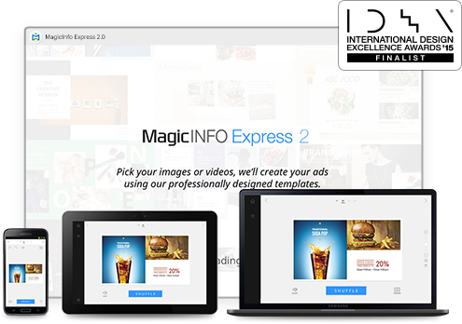
MagicInfo Express 2
Basic digital signage, that does not require a separate media player, provided at no additional cost.
MagicInfo Express 2 runs on the SoC in S3/S4/S5/S6 Player LFDs.
Express 2 software can be installed on Windows, Mac, Android, or iOS.
Express 2 connects to the LFD via a network. If no network is present, a direct Wi-Fi connection can be set up on the LFD (Soft Access Point).
Express 2 can also publish content via USB storage devices.
Plays photos, videos, PowerPoint, PDF, external sources (via PiP), and allows for multi-zone template creation from a library of pre-created layouts.
No license required.

Slide 4
MagicInfo Lite
Basic digital signage, that does not require a separate media player, provided at no additional cost.
MagicInfo Lite runs on the onboard SoC (System on a Chip) within Samsung commercial LFDs.
Utilizes a standard IP network (wired or wireless).
Plays photos, videos, Flash, PDF and PowerPoint, in full screen only.
Uses MagicInfo Server 7 for centralized management of LFDs.
Includes 25 free licenses with the install of the Server software.
Additional licenses can be purchased with part number CY-MILSSTS. Each display added must have a license.

Slide 5
MagicInfo Premium
Samsung’s flagship digital signage solution offering the most features and capabilities.
There are two types of player for MagicInfo Premium – S Player, which runs on the SoC (system on a chip) embedded in Samsung commercial LFDs, and Player I, which runs on a user-supplied Windows PC.
Utilizes a standard IP network (wired or wireless).
Offers custom multi-zone template capability and embedding PiP to add live video to templates.
Compatible with MagicInfo Premium Author software for advanced template creation.
Uses MagicInfo Server 7 for centralized management of LFDs.
One license is required per display, part number BW-MIP40PA. This unified license works with both player types.
There is a 60-day trial for up to 5 monitors available on the server software.

Slide 6
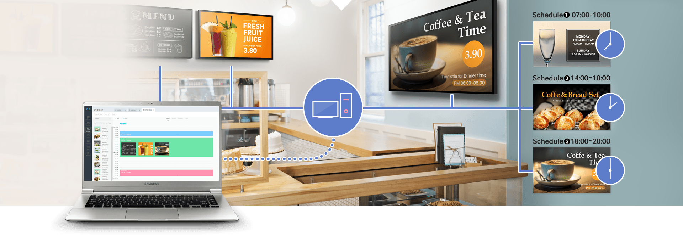
The MagicInfo 7 Server
The MagicInfo Server is a browser-based software system that manages and controls content and devices, allowing the user to organize and publish content.
The MagicInfo Server is on-premise software (self hosted) using a Windows based PC.
The user accesses this software from a standard web browser, connecting to the server PC over the network, or the Internet.
Because the system is designed to be web based, a user can connect to the server and interact with it remotely.
MagicInfo Server supports multiple LFDs across multiple sites, with multiple users, and does so simultaneously.

Slide 7
MagicInfo Licensing
The MagicInfo License Ordering Process:
Reseller receives PO from customer
Reseller sends PO to distributor
Distributor provides order form
End user completes order form
Reseller sends order form to distributor
Distributor sends PO / order form to Samsung
Samsung issues license key via email

Slide 8
For more information, contact your local Samsung representative, or Brawn Consulting:
1 (866) 754-6450
samsunglfd@brawnconsulting.com
Jonathan Brawn
Principal
Brawn Consulting
E: jonathan@brawnconsulting.com
Brian Kosich
Engineering Services Manager
Brawn Consulting
E: brian@brawnconsulting.com
Thanks for Attending!

