Slide 1
Introducing MagicInfo Lite
Q4 2019

Slide 2
The MagicInfo Concept
What is Samsung MagicInfo?
Samsung MagicInfo is a family of turnkey digital signage solutions for Samsung SMART Signage LFDs, designed to provide high quality digital signage simply, and at a lower cost.
MagicInfo is designed to allow a user to build a digital signage system of any size as easily as possible, and centrally manage it over a network from a PC with installed MagicInfo Server software.
MagicInfo consists of two parts:
The MagicInfo player software embedded into the System on a Chip (SoC) media player or installed on a user supplied PC for each display.
MagicInfo Server 7 software to be installed on a networked Windows PC, supplied by the user.

Slide 3
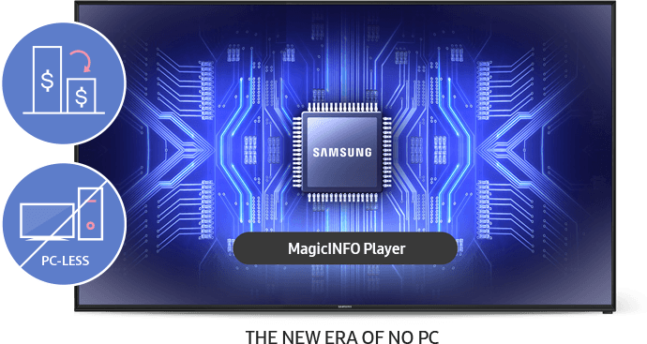
The Benefits of MagicInfo
MagicInfo offers cost effective digital signage as a turnkey solution from a single manufacturer.
It removes the need to integrate a separate media player into the display system.
It eliminates dealing with multiple sources and/or signal distribution.
MagicInfo provides easy content scheduling, detailed hardware management, and full remote control.
MagicInfo features simple configuration and easy to use interfaces.

Slide 4
Introducing MagicInfo Lite

Slide 5
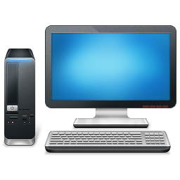
Introducing MagicInfo Lite
MagicInfo Lite is Samsung’s entry level enterprise-class digital signage software.
Included with every SMART Signage LFD, is an onboard SoC (System on Chip) media player.
This player, while not potentially as powerful as a full dedicated PC, offers complete digital signage functionality, at no additional cost.

Slide 6
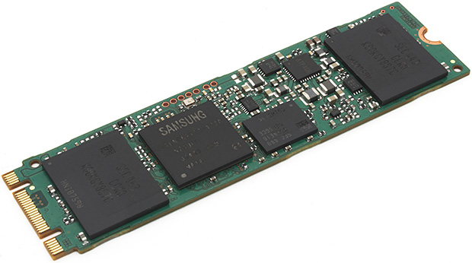
MagicInfo Player - SoC
The onboard MagicInfo Player, a system on a chip (SoC), allows you to play specific types of content files, either on demand, or according to a basic schedule.
All SoC LFDs are equipped with an onboard USB port, for connecting standard USB flash drives.
Content can be played directly from an attached USB drive, or from internal memory.

Slide 7
MagicInfo Lite - Stand Alone
There are some applications where a network to connect the Samsung LFD and a server PC is not possible. In those instances, the user can make use of MagicInfo Lite as a stand-alone device.
When used stand alone, without being networked to a MagicInfo Server, the user can manage digital signage directly on the LFD by using the IR remote control:
Play content files directly from the on-screen menus.
Create basic schedules for content play back.
Review network published schedules.

Slide 8
MagicInfo Lite - Networked
MagicInfo Lite Players can also be used to build a networked enterprise class digital signage system.
By installing MagicInfo Server on a Windows PC, and connecting it to a network, multiple MagicInfo Lite LFDs can be connected and allow for centralized management, content publishing, and scheduling.
LFDs can be on the same network as the server, or on different networks, connected via the Internet.
The Server comes with the first 25 LFDs licensed at no cost to the user.
Additional displays may be added using a purchasable license per display to be added.
(part CY-MILSSTS).

Slide 9
MagicInfo Lite Content
MagicInfo Lite supports the following content file types, displayed only in full screen:
Image Files
Video Files
PowerPoint Files
Flash Files
PDF Files

Slide 10
For more information, contact your local Samsung representative, or Brawn Consulting:
1 (866) 754-6450
samsunglfd@brawnconsulting.com
Jonathan Brawn
Principal
Brawn Consulting
E: jonathan@brawnconsulting.com
Brian Kosich
Engineering Services Manager
Brawn Consulting
E: brian@brawnconsulting.com
Thanks for Attending!

