Slide 1
Introducing MagicInfo 7
A Powerful and Comprehensive Platform for Signage

Slide 2
The MagicInfo Concept
What is Samsung MagicInfo?
Samsung MagicInfo is a family of turnkey digital signage solutions for Samsung SMART Signage LFDs, designed to provide high quality digital signage simply, and at a lower cost.
MagicInfo is designed to allow a user to build a digital signage system of any size as easily as possible, and centrally manage it over a network from a PC with installed MagicInfo Server software.

Slide 3
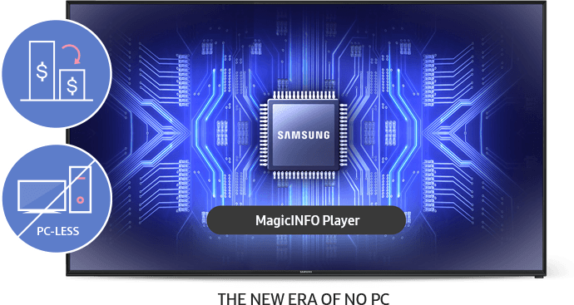
The Benefits of MagicInfo
MagicInfo offers cost effective digital signage as a turnkey solution from a single manufacturer.
It removes the need to integrate a separate media player into the display system.
It eliminates dealing with multiple sources and/or signal distribution.
MagicInfo provides easy content scheduling, detailed hardware management, and full remote control.
MagicInfo features simple configuration and easy to use interfaces.

Slide 4
Introducing MagicInfo 7

Slide 5
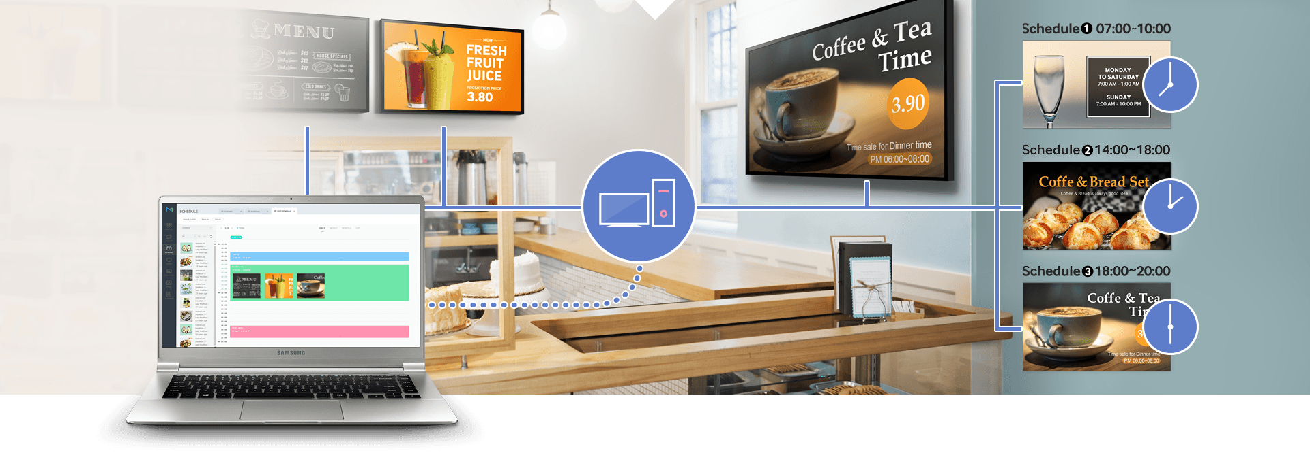
Introducing MagicInfo 7
MagicInfo 7 is the latest generation of all-in-one digital signage solutions from Samsung.
MagicInfo 7 is designed from the ground up to deliver a true enterprise class solution that can meet the demands of any digital signage application.
MagicInfo 7 is intended to perform competitively to other mainstream digital signage CMS packages, with the benefit of simpler integration supported by a single manufacturer.
It offers a complete set of tools, including playback reporting, dynamic database integration, and camera-based content triggering.
MagicInfo 7 can scale to any size of network, spanning as many sites as desired.

Slide 6
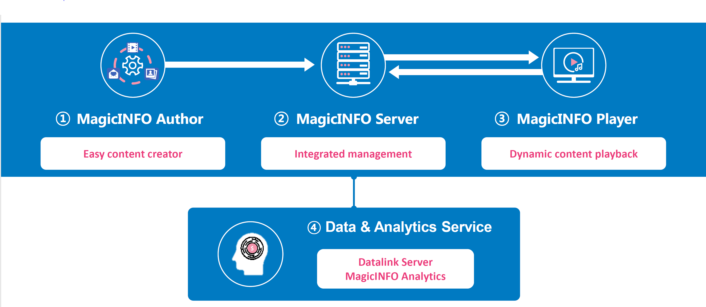
Parts of a MagicInfo System

Slide 7
MagicInfo System Architecture
Network
Wired / Wireless
Internet
Connection
User Workstation With
Author and Web Interface
PC with
MagicInfo Server
(VM or Physical)
No license needed
Local LFD with
MagicInfo SoC Player
Remote LFD with
MagicInfo SoC Player
MagicInfo Server does not require a license
Each LFD that connects to a Server will require 1 license to allow connection

Slide 8
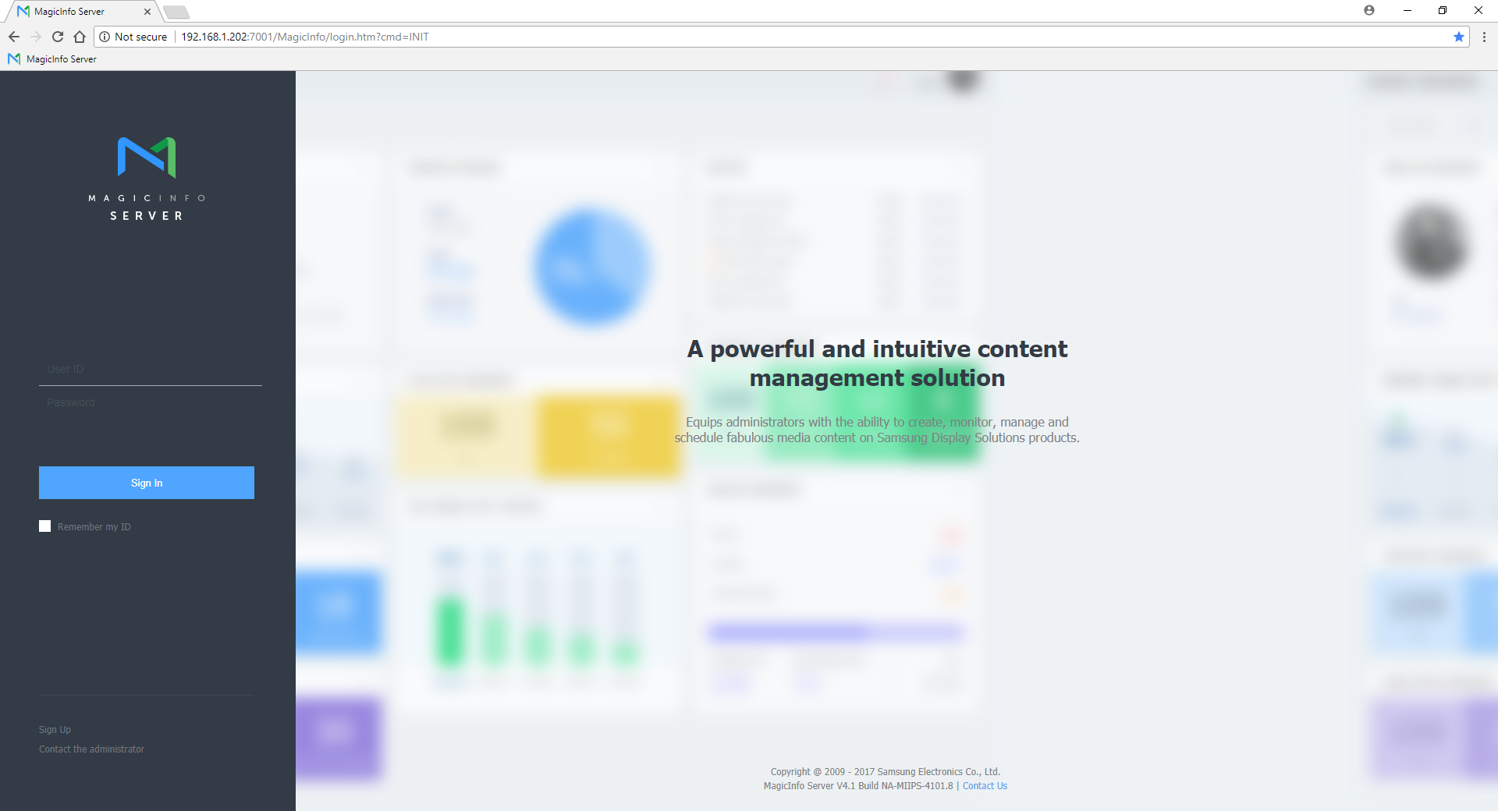
MagicInfo Server
The MagicInfo Server is Windows software that works in conjunction with an SQL database to provide an easy to use web-based interface for any number of users.
These HTML5 web pages can be loaded from any compliant browser that has network access.
They are also mobile responsive.
Users may load the MagicInfo Server into an on-premise PC, either physical or virtual.
The software may also be loaded into cloud computing platforms such as Microsoft Azure or Amazon Web Services as desired.

Slide 9
MagicInfo Players
There are three types of MagicInfo Player:
Lite Player
SoC LFDs
Centralized management via MagicInfo Server
S Player
SoC LFDs
I Player
3rd Party PC
Utilized with videowalls, complex animations, transparent layering
Simple but comprehensive features.
Full screen photo, video, PDF, and PPTX playback
Centralized Management via MagicInfo Server with Remote Management
Advanced and dynamic content capabilities
Multiple zones of content
Proof of play and full reporting
Supports interactive content
Supports external devices (like cameras for SPOT)
Can support non-Samsung displays

Slide 10
MagicInfo Workflow
The user creates content, by taking standard computer content files and uploading them to the MagicInfo Server, or building them into a dynamic multi-zone layout using the MagicInfo Web Author or Premium Author.
The user then can utilize the browser-based interface provided by the server to manage the uploaded content and assign it to various schedules.
Schedules are then assigned to players, and the server publishes them over the network, or via the Internet, to the storage of the player.
The MagicInfo player software then begins playback of the scheduled content.

Slide 11
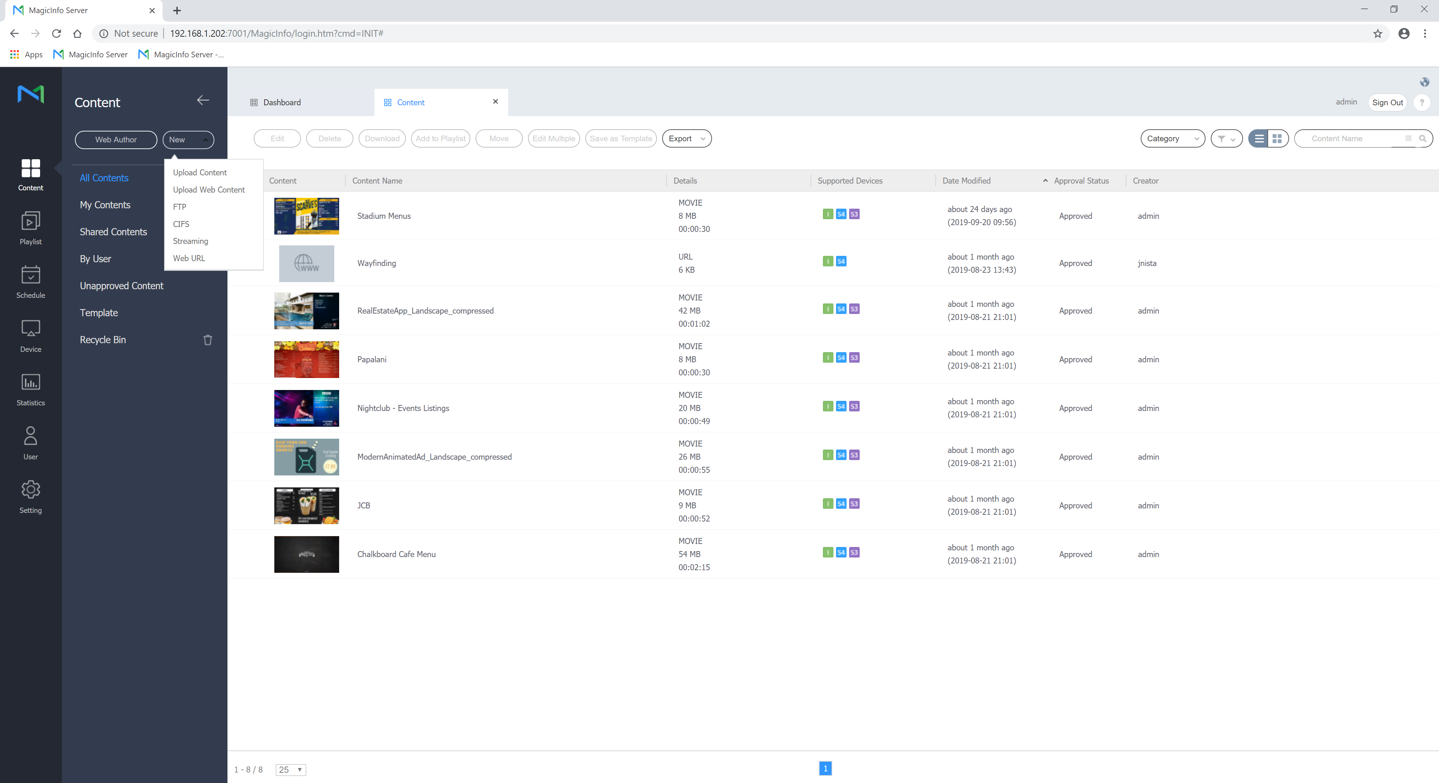
Content Management Library
MagicInfo Server features an easy to use content management library function.
Content can be uploaded by users from their workstations, where it is centrally stored.
In addition to standard file types, MagicInfo Premium can support:
IPTV streams (H.264)
Direct CIFS/FTP file shares
Web pages – online and offline (as .zip)
Content can be organized into groups, and then used in playlists or incorporated directly into schedules.
Tags can be used to place content into playlists and schedules for automatic deployment.

Slide 12
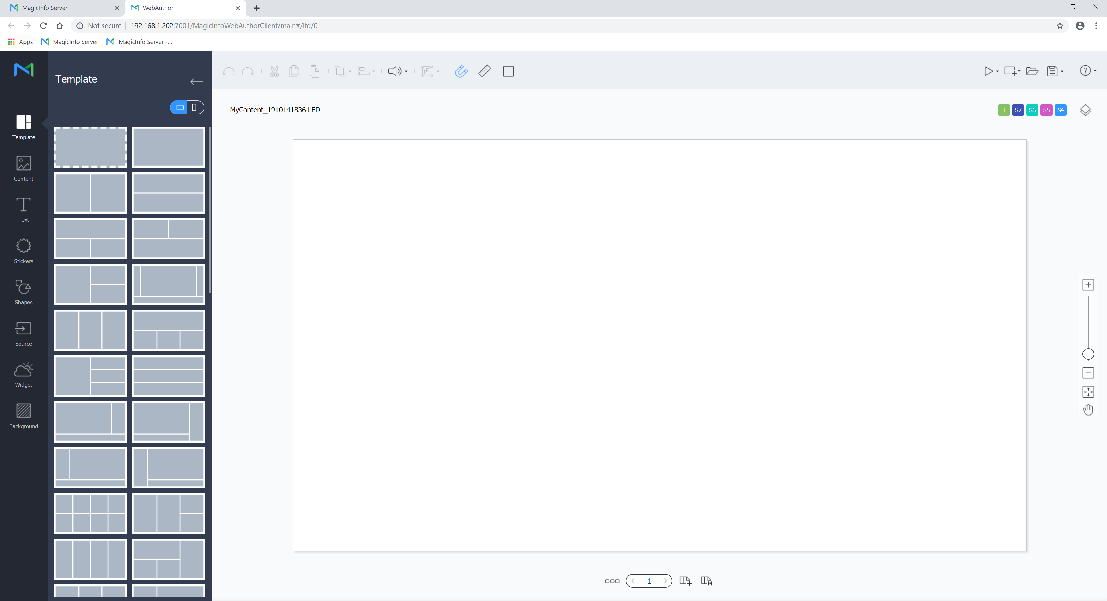
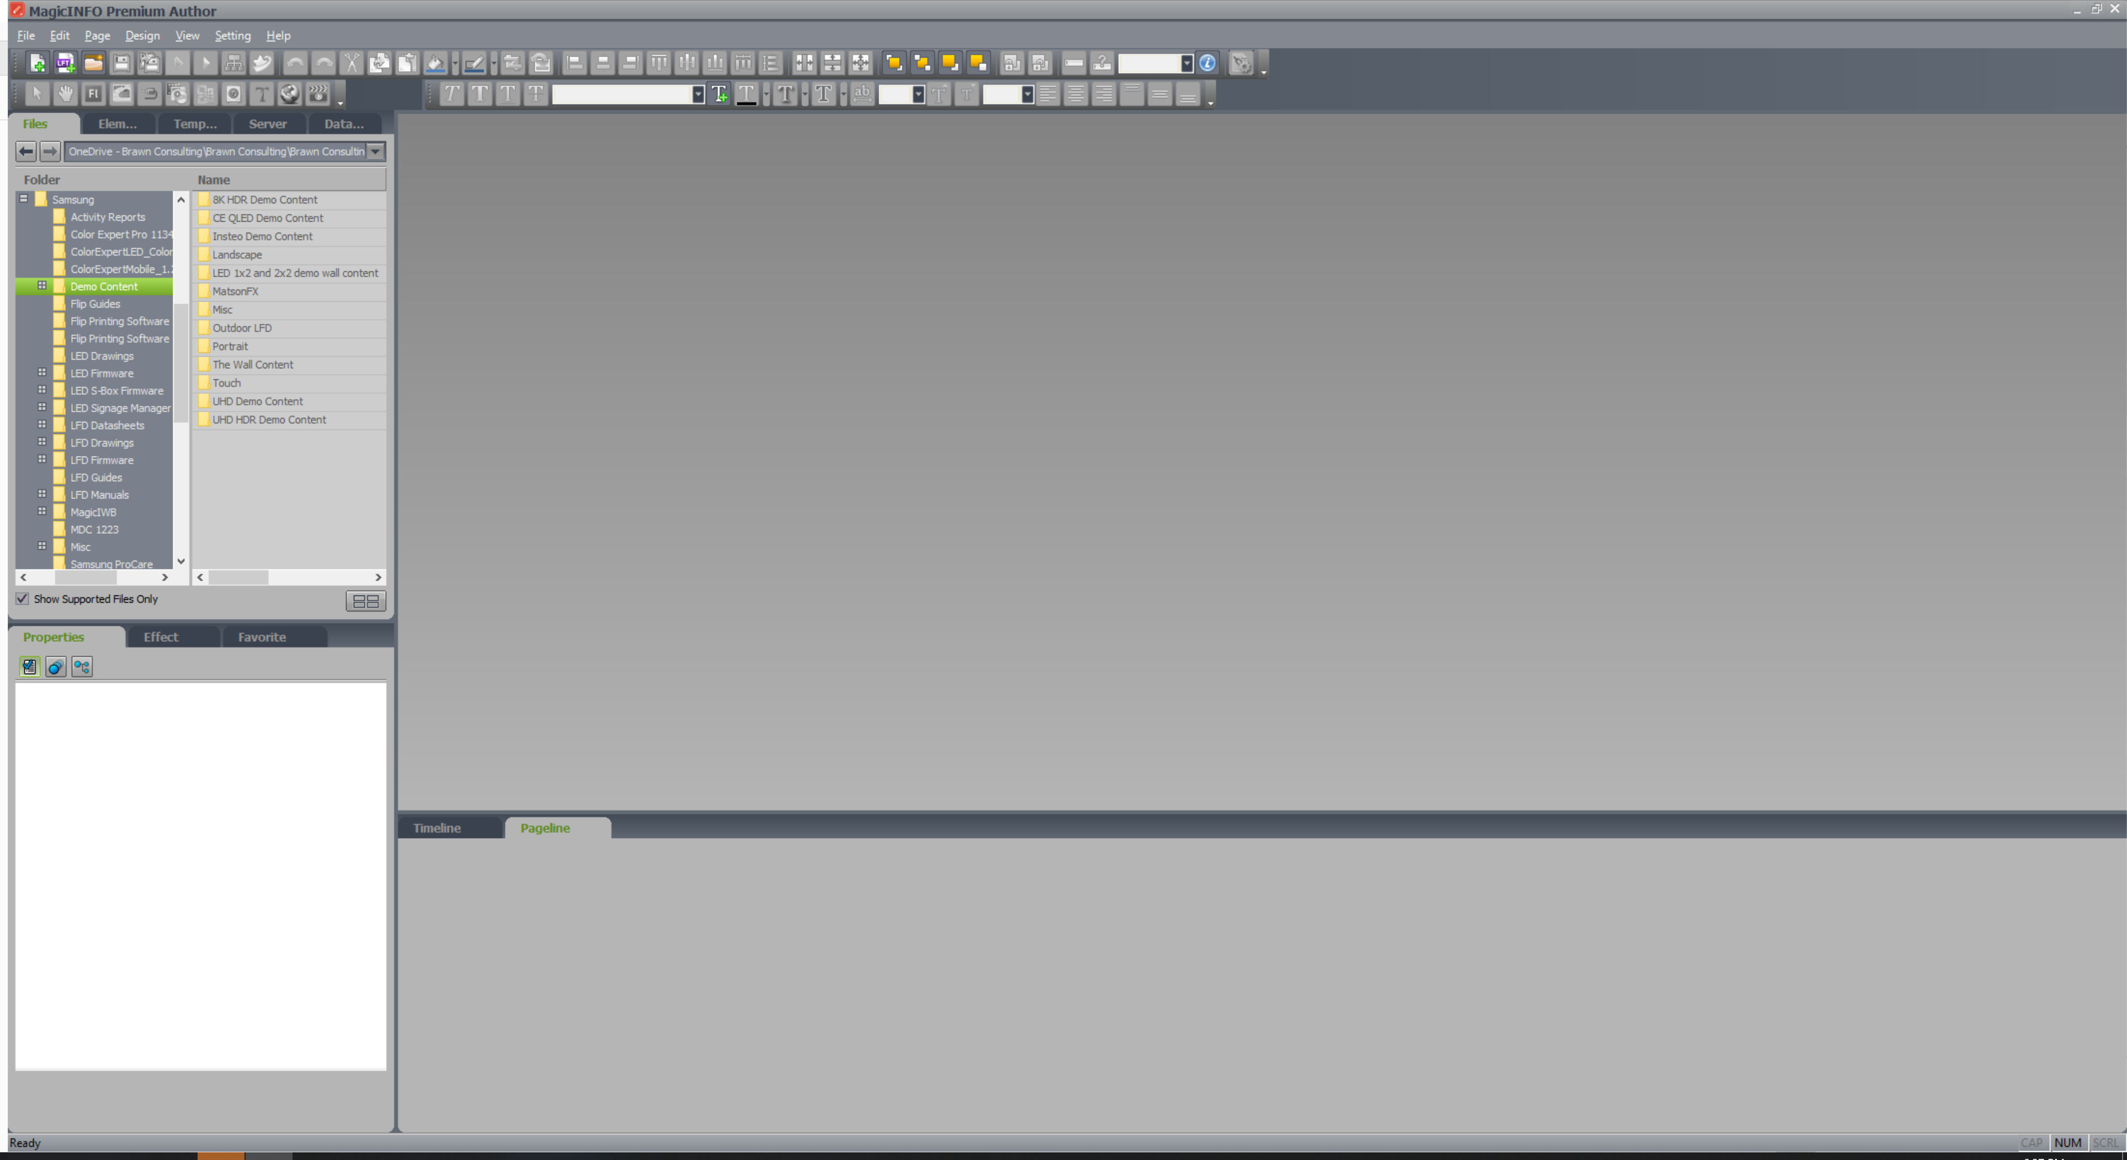
Web Author / Premium Author
Using the server integrated Web Author, or the PC based Premium Author, users can create multi-zone layouts. Both Authors also allow the user to add dynamic content like RSS and MRSS feeds, or the included widgets.
Web Author and Videowall Author can also be used to create videowall layouts.

Slide 13
Supported Content
MagicInfo Premium allows the use of many types of content files:
Photos and image files
Music (audio) files
Movie (video) files
Office (Word, PowerPoint, Excel) files
Adobe Flash and PDF files
HTML content as a live URL or offline as a .ZIP
RSS / MRSS feeds
External video inputs (LFD PiP)
Directly linked database sources (using optional DataLink add-on)
IPTV streams
User supplied TrueType fonts

Slide 14
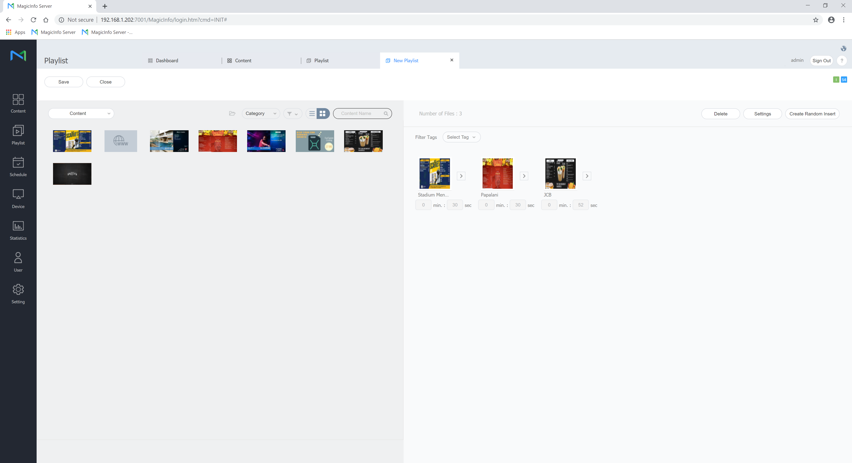
Powerful Playlist Creation
Users can combine multiple files (and multiple file types) into a single playlist for ease of scheduling.
MagicInfo Premium can also offer synchronization of content (sync playlist), random file inserts, and tag based playlisting (for automation).
Premium also supports nested playlists, to allow for detailed management and user access control.
Items in a Premium playlist can be set to expire as needed.

Slide 15
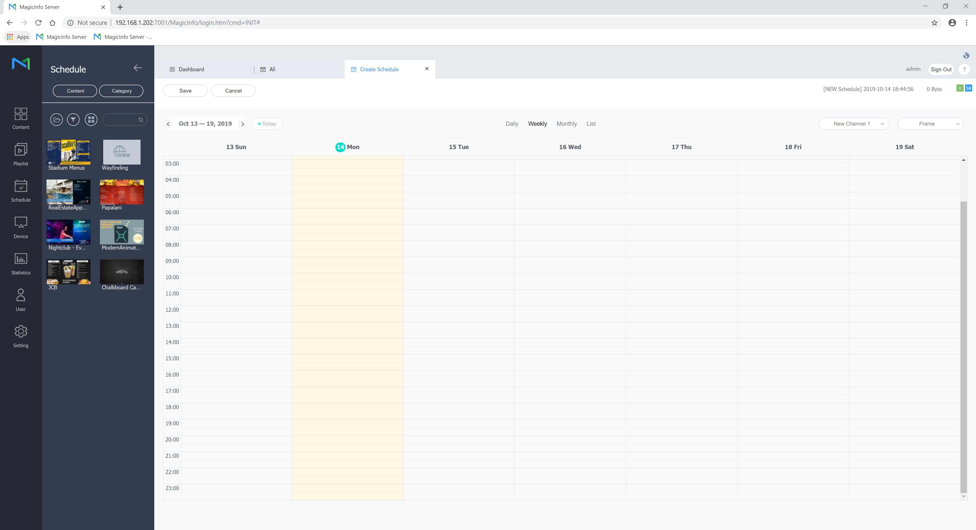
Simple Scheduling
MagicInfo provides a simplified calendar-based scheduling interface.
Users can add content from their library, or files created in Author.
Each content element has its own duration, and can be set for daily, weekly, or monthly repetition.
Once completed, saving the schedule will prompt the user to select which players or groups of players the schedule will be assigned to. Publishing is automatic on save.

Slide 16
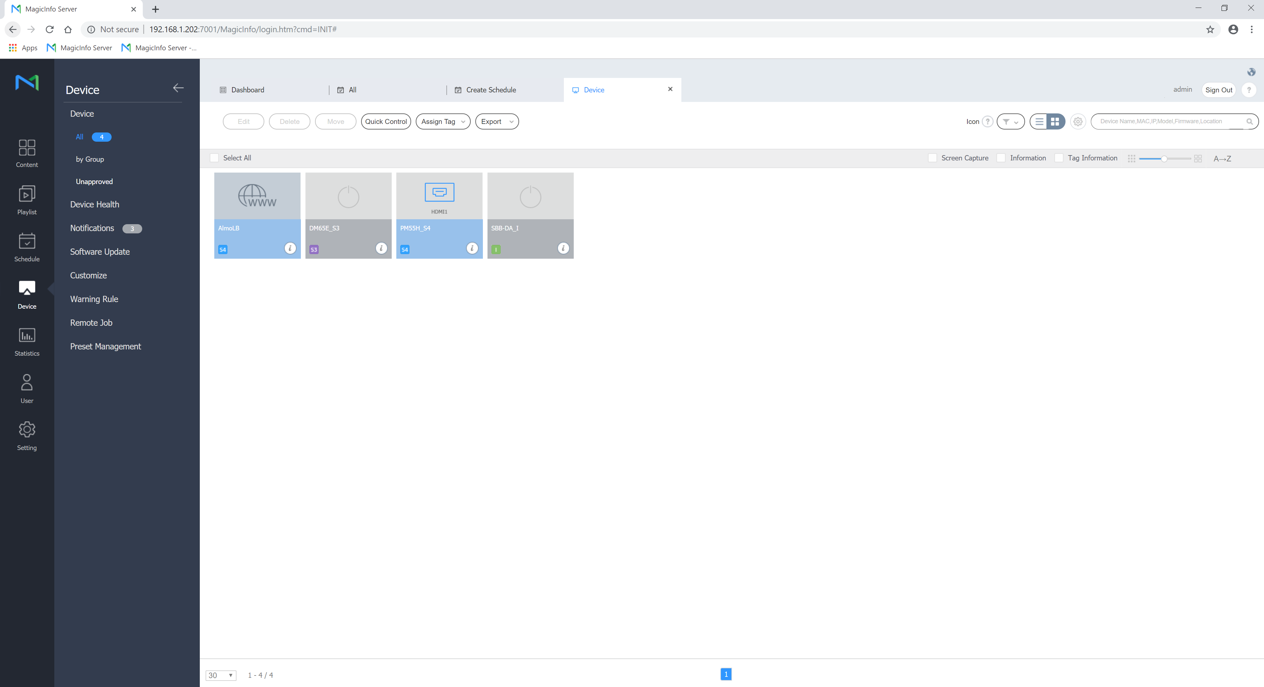
Robust Device Management
The MagicInfo server offers the user a unique dashboard to manage all connected players and Samsung LFDs.
The server proactively monitors the health and status of connected players, with notifications and emails to configured users.
Premium users can control all settings of a connected Samsung LFD.
With MagicInfo Premium, a full virtual remote control allows a live look at what is being displayed on each LFD in the network.

Slide 17
MagicInfo Licensing
Category | Product | License Type | License Part
CMS Solution | MagicInfo Server | 1 Per Player | BW-MIP40PA | MagicInfo Premium Unified server license (S/I Player connector)
 |  |  | CY-MILSSTS | MagicInfo Lite server license (Player connector)
 | Videowall Author | 1 Per Install | BW-MIV20AW | Videowall content creation for I Players
 |  |  | BW-MIV20AS | Videowall content creation for S Players
RM Solution | MagicInfo RM | 1 Per Player | BW-RMS40SA | Remote device management for SSSP or non-signage LFDs
Data Service | Datalink Server | 1 Per Player | BW-MIE30DA | Connect with external database sources

Slide 18
MagicInfo Licensing
The MagicInfo License Ordering Process:
Reseller receives PO from customer
Reseller sends PO to distributor
Distributor provides order form
End user completes order form
Reseller sends order form to distributor
Distributor sends PO / order form to Samsung
Samsung issues license key via email

Slide 19
For more information, contact your local Samsung representative, or Brawn Consulting:
1 (866) 754-6450
samsunglfd@brawnconsulting.com
Jonathan Brawn
Principal
Brawn Consulting
E: jonathan@brawnconsulting.com
Brian Kosich
Engineering Services Manager
Brawn Consulting
E: brian@brawnconsulting.com
Thanks for Attending!

