Slide 1
Easy Digital Signage:
MagicInfo Express 2
Q4 2019

Slide 2
Easy Digital Signage:
MagicInfo Express 2
Q4 2019

Slide 3
MagicInfo Express 2: All-in-one Digital Signage For Everyone
Building on a successful family of integrated digital signage solutions, Samsung has introduced a free, entry level digital signage application, MagicInfo Express 2.
A true all-in-one solution, MagicInfo Express 2 is aimed at making digital signage affordable and easy to deploy for anyone.
Everything required to create compelling digital signage is included in a single box.

Slide 4
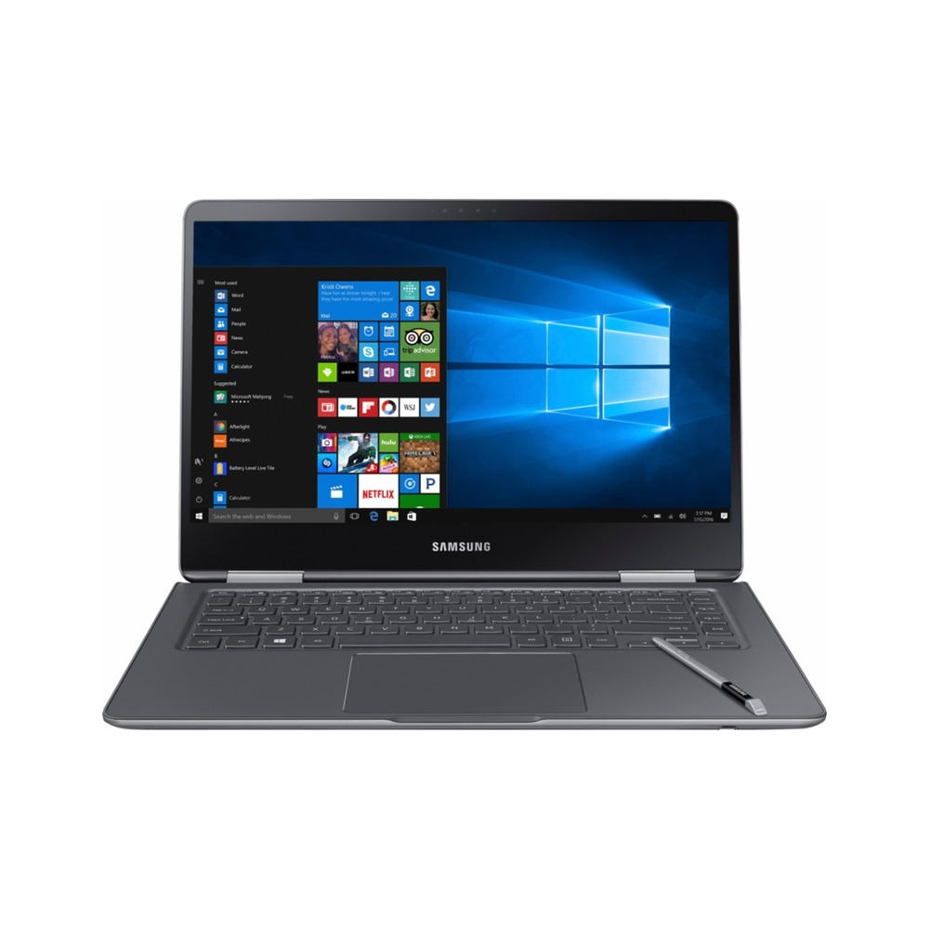
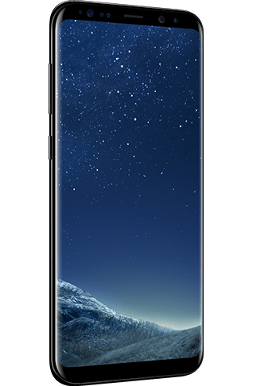
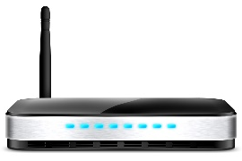
The MagicInfo Express 2 Concept
What is MagicInfo Express 2?
MagicInfo Express is an all-in-one solution to high quality digital signage that is easy to use and low cost.
It is designed to allow a user to build a digital signage system as simply as possible.
MagicInfo Express 2 consists of two parts:
The (SoC) media player embedded in a SMART Signage LFD (S3/S4/S5/S6 Player)
MagicInfo Express 2 software on a networked computer or mobile device.
SMART Signage LFD
Computer or Mobile Device with MagicInfo Express 2
Notes:
MagicInfo Express 2 is compatible with: RMD, RHE, and all S3, S4, and S5 Player LFDs. RMD and RHE use basic mode for MagicInfo Express 2.
DCE/DCH/DCJ NOT COMPATIBLE. S2 AND EARLIER PLAYERS NOT COMPATIBLE.

Slide 5
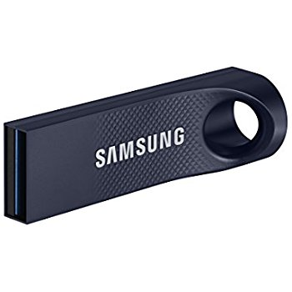
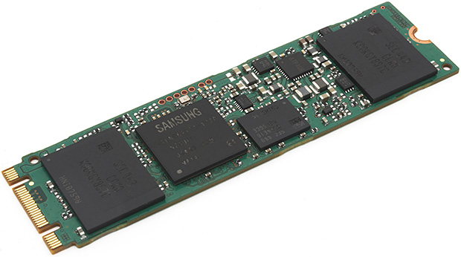
Introducing MagicInfo Express 2
MagicInfo Express is Samsung’s free entry-level digital signage software.
Included with every SMART Signage LFD, is an onboard SoC (System on Chip) media player.
This player offers complete digital signage functionality, at no additional cost.
Each LFD has a USB port for connecting storage devices, and onboard flash storage.
Displays have embedded networking to connect to computers and mobile devices running MagicInfo Express 2 software.

Slide 6
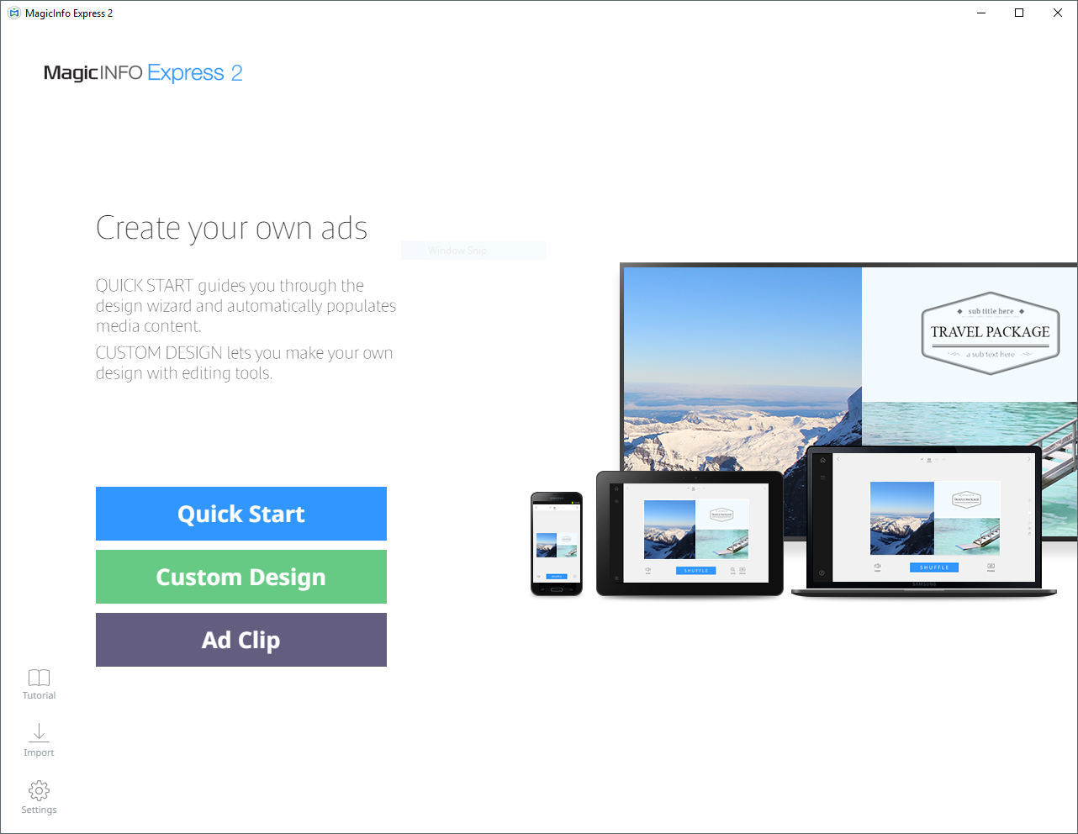
MagicInfo Express 2
Included in the package is the easy to use MagicInfo Express 2 software.
This simple program makes setting up digital signage incredibly easy, with no configuration required.
The software supports Windows, Mac OSX, and apps are available for Android and iOS.
Just install it on a computer or mobile device on the same network as the SMART Signage LFD, and it will detect them automatically.

Slide 7
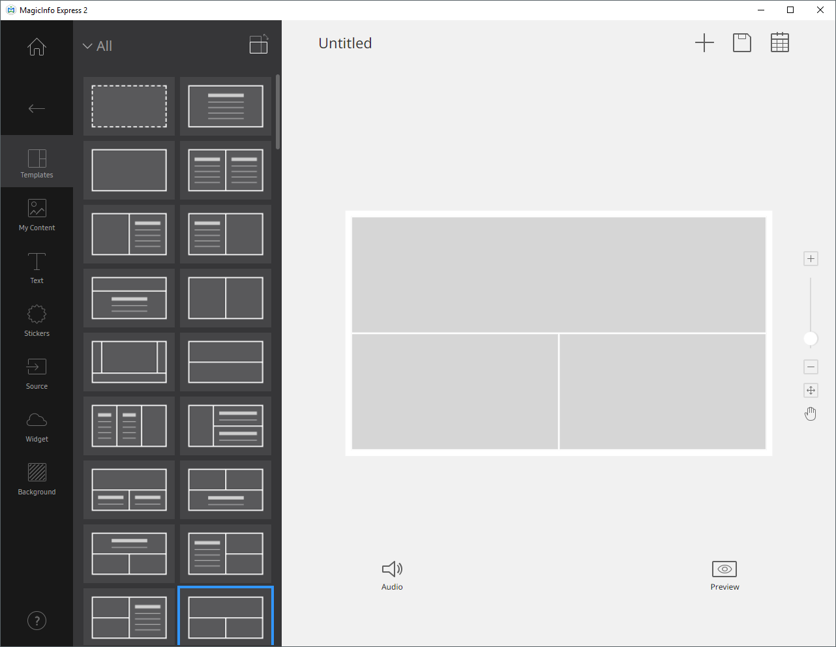
MagicInfo Express 2
MagicInfo Express 2 includes 200 professionally designed templates, with both portrait and landscape configurations.
There are a variety of templates from many different applications.
MagicInfo Express 2 offers both guided content creation (where the application will walk you through and automate creating signage) and custom content creation (where you completely control creating signage).

Slide 8
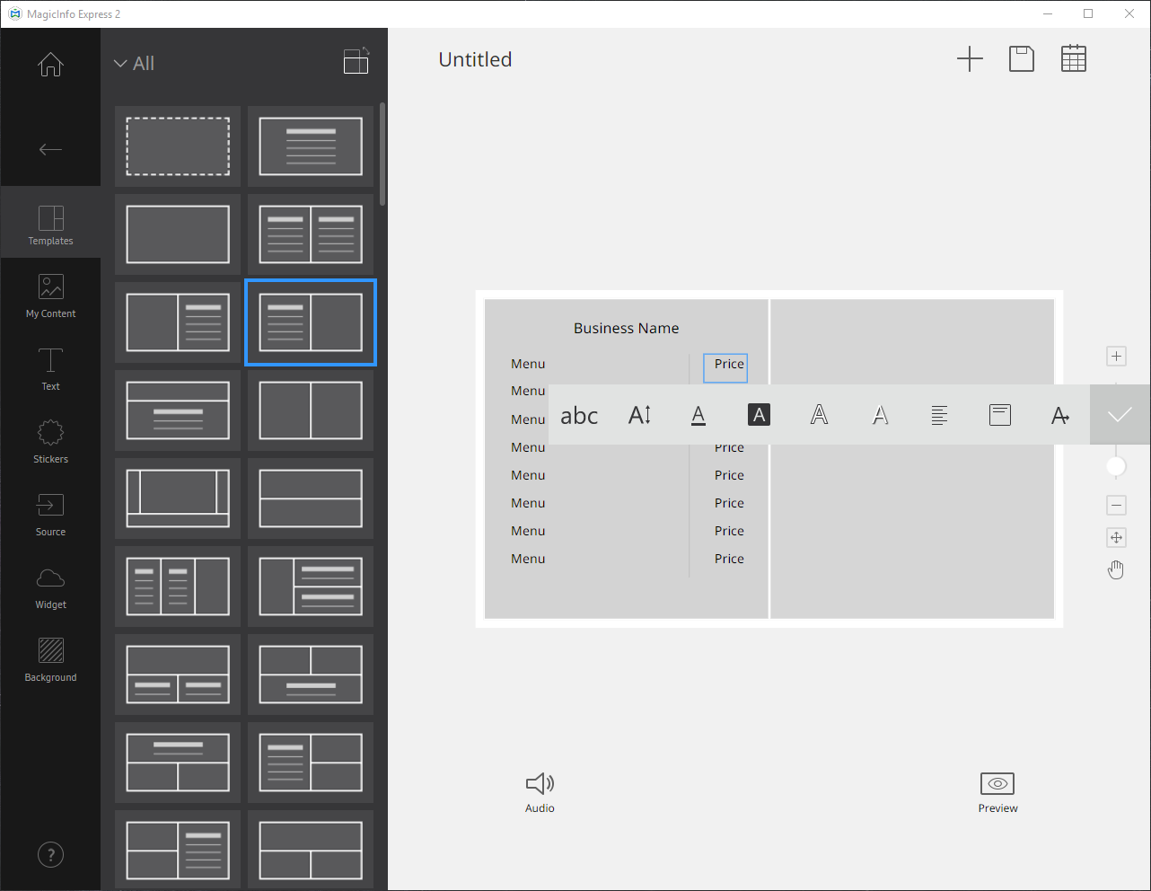
MagicInfo Express 2
Each template can be edited, to insert your own text, video, photos, or PowerPoint documents.
Multiple files can be combined into playlists for each zone, if desired.
Stickers and widgets such as weather are provided to add to templates.
External video (from the LFD’s video inputs) can be incorporated into your designs.

Slide 9
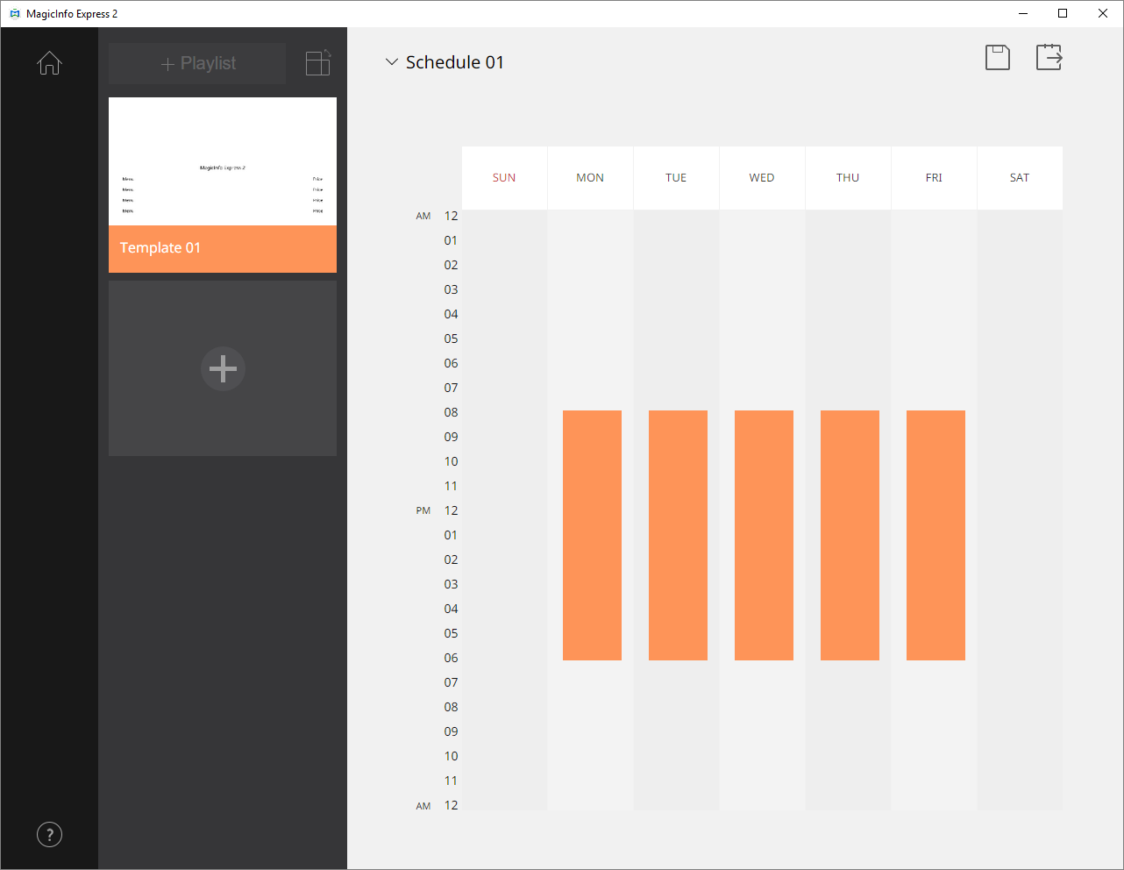
MagicInfo Express 2
Scheduling templates to play is intuitive, including adding on/off timers.
Multiple templates can be scheduled to play one after another, if desired.

Slide 10
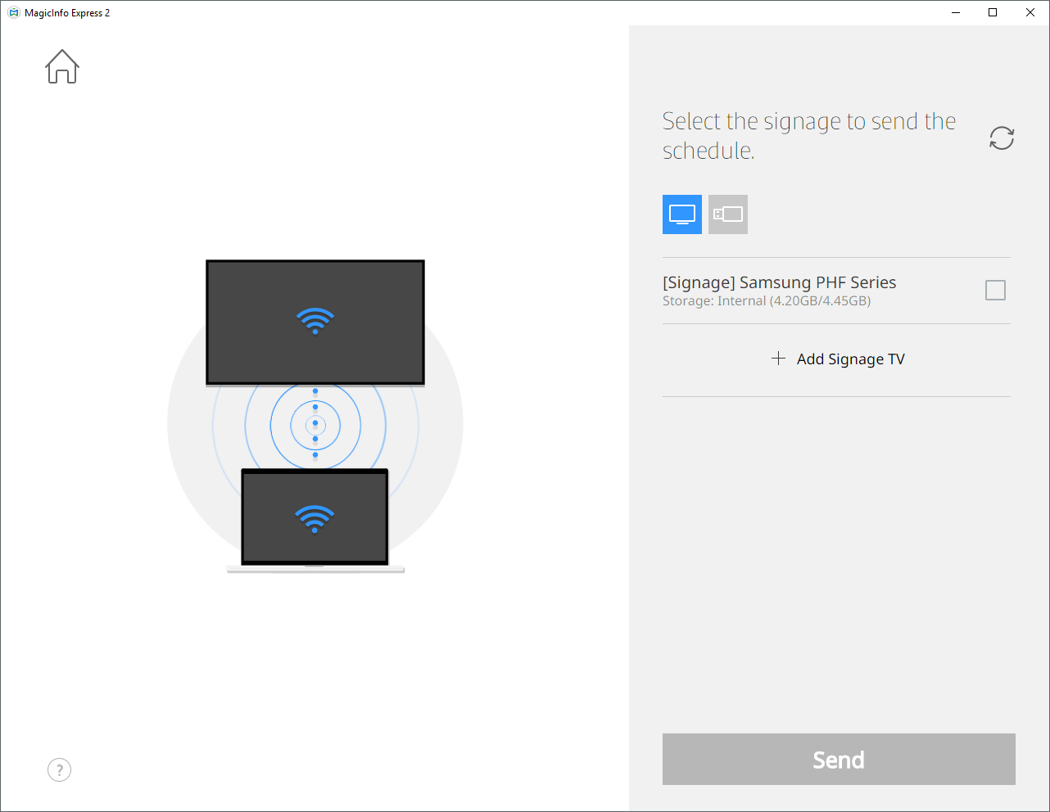
MagicInfo Express 2
MagicInfo Express 2 can then directly send the created schedule to one or more displays over the network.
Simply select which displays will receive the schedule, and click SEND.
Content will be downloaded into the display and playback will begin.
Content may also be published to a USB flash drive for offline playback.

Slide 11
For more information, contact your local Samsung representative, or Brawn Consulting:
1 (866) 754-6450
samsunglfd@brawnconsulting.com
Jonathan Brawn
Principal
Brawn Consulting
E: jonathan@brawnconsulting.com
Brian Kosich
Engineering Services Manager
Brawn Consulting
E: brian@brawnconsulting.com
Thanks for Attending!

