Slide 1
LFD Firmware:
Updating Via USB
Q2 2019

Slide 2
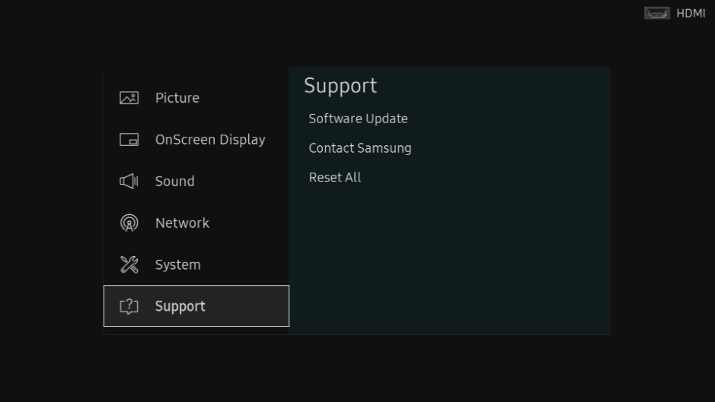
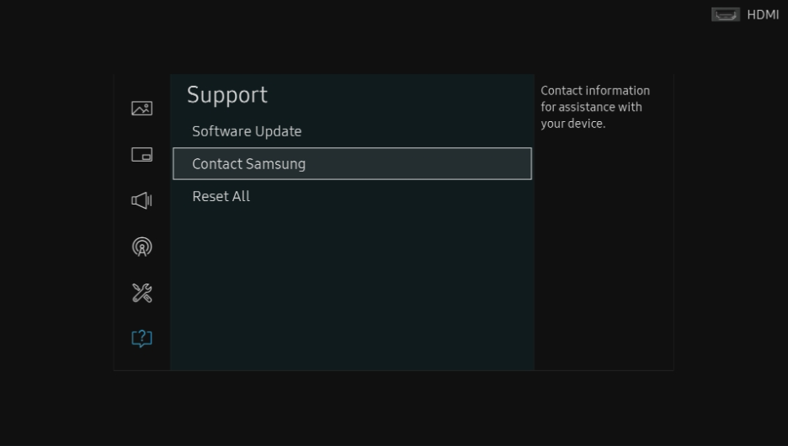
Checking Firmware Revisions
To verify the firmware revision on your LFD, on the IR remote control, press “Menu”, then select “Support”, then “Contact Samsung”.

Slide 3
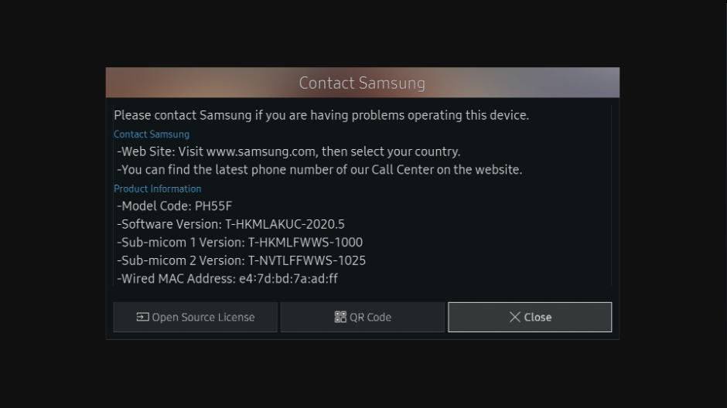
Checking Firmware Revisions
The screen will list multiple firmware versions, for different chipsets called “micoms”.
Please note all versions. Different LFD models may have more than one micom.

Slide 4
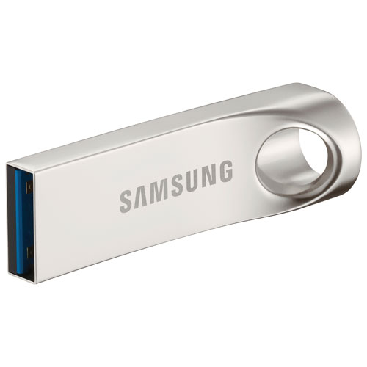
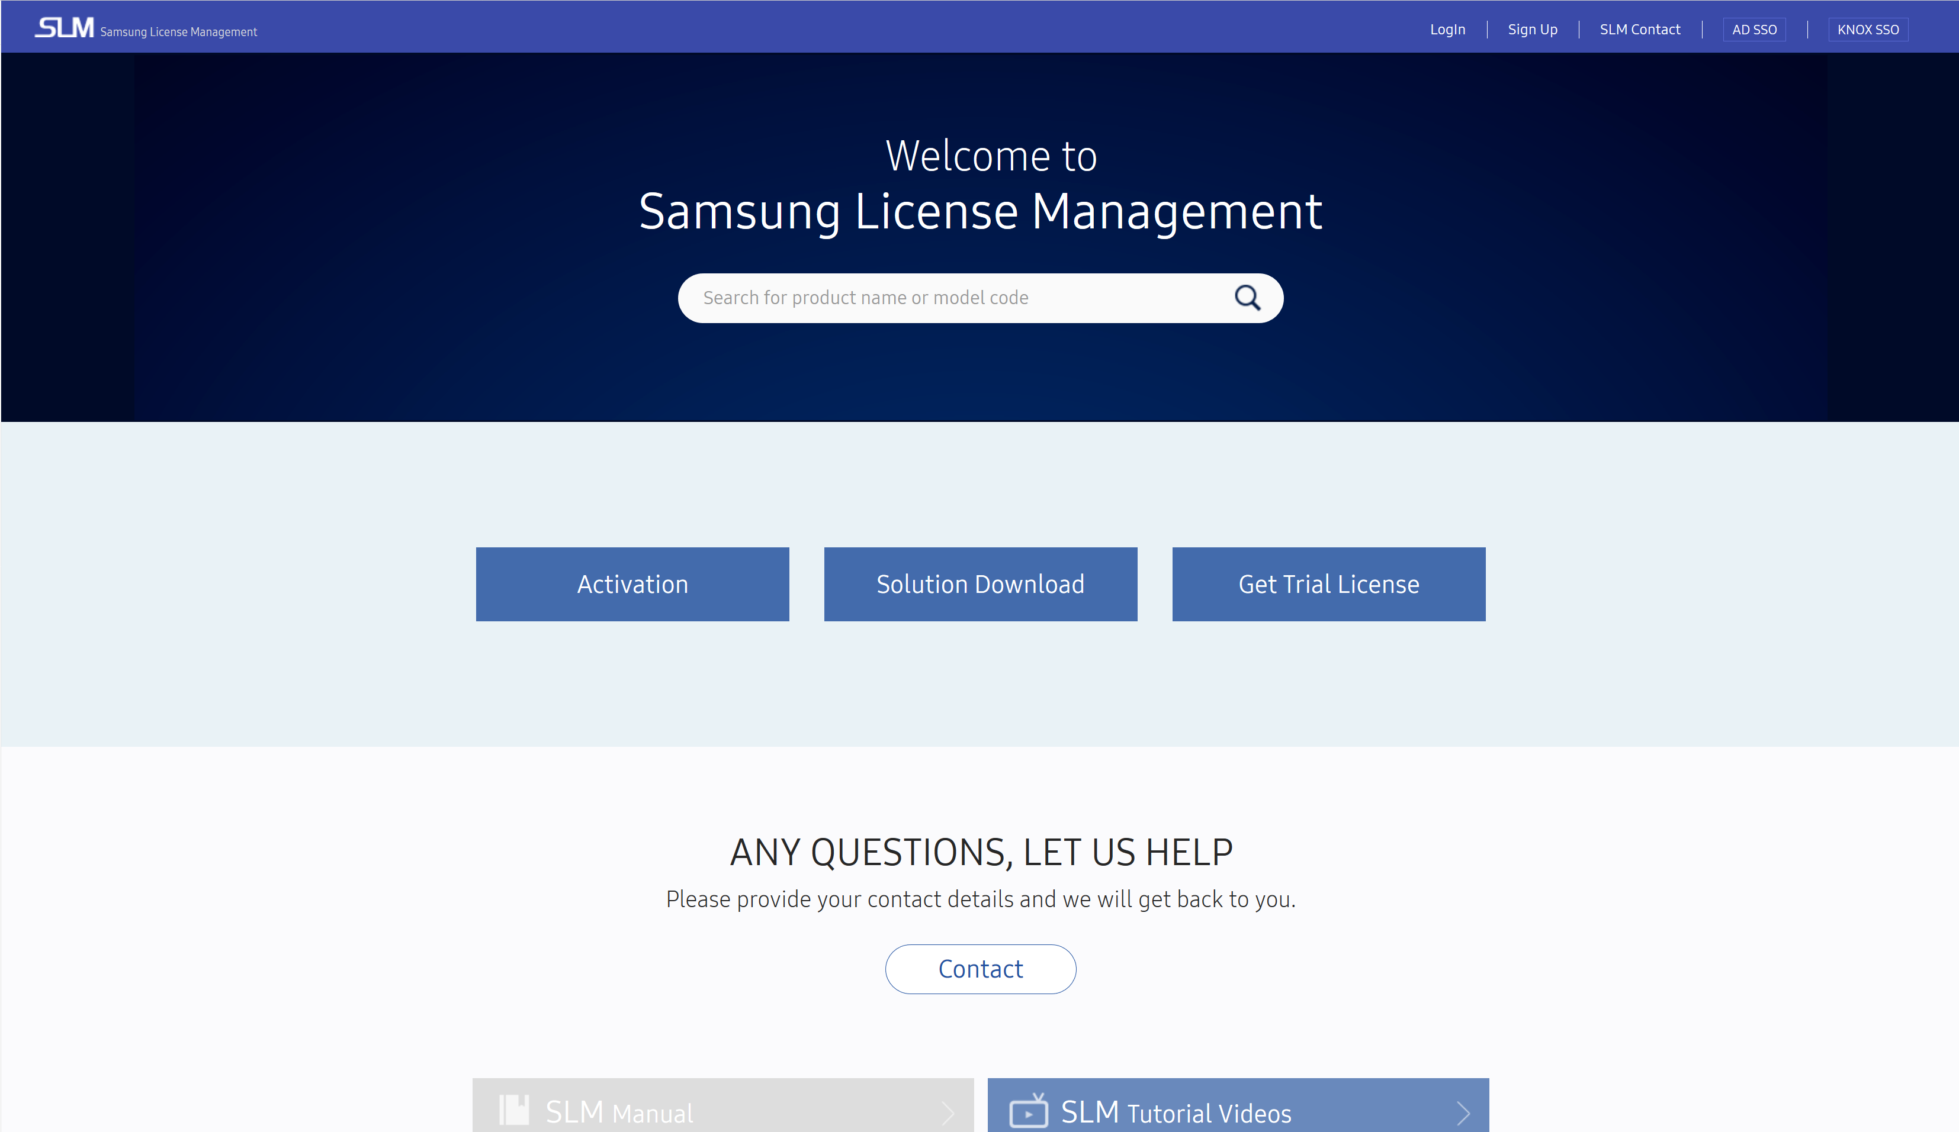
Updating LFD Firmware
LFD Firmware can be obtained from the SEC SLM, http://www.secslm.com
Ensure that you download the firmware for your specific LFD model.
To update via USB flash drive, you will need a blank, FAT32 formatted drive, large enough to hold the firmware file (1GB minimum).

Slide 5
Updating LFD Firmware
Download the firmware file from the SEC SLM.
Unzip the firmware file and copy the folder to the USB flash drive.
Rename the firmware folder:
For D generation LFDs - T-GFSLAKUC
For E generation LFDs - T-GFSLE2AKUCT
For F / H / J generation LFDs - T-HKMLAKUC
For N generation LFDs - T-KTM2ELAKUC
The firmware folder must be named correctly for the LFD to recognize it.
Note: Your LFD may require multiple updates, for the main and sub-micoms. Refer to the SEC SLM for your LFD model.

Slide 6
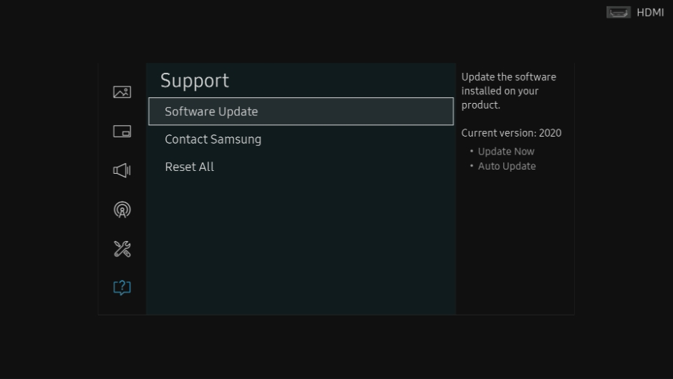
Updating LFD Firmware
Insert the USB flash drive into the USB port of your LFD.
Ensure that the onboard player is not active, by switching to an input like HDMI 1.
On the IR remote, press “Menu”, then select “Support”.
From the Support Menu, select “Software Update”.

Slide 7
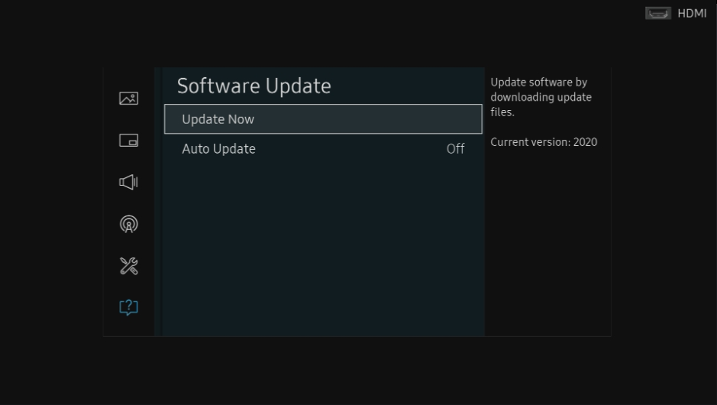
Updating LFD Firmware
Select “Update now”.
The LFD will check for updated firmware on the USB, and prompt you to update. Select “OK”.
The LFD will now update, and restart when complete.
For E/F/H generation LFDs, this cycle will repeat for multiple micoms.

Slide 8
For more information, contact your local Samsung representative, or Brawn Consulting:
1 (866) 754-6450
samsunglfd@brawnconsulting.com
Jonathan Brawn
Principal
Brawn Consulting
E: jonathan@brawnconsulting.com
Brian Kosich
Engineering Services Manager
Brawn Consulting
E: brian@brawnconsulting.com
Thanks for Attending!

