Slide 1
BEN Series LFD EX-LINK Guide
Q2 2019

Slide 2
EX-LINK Control
EX-LINK is a Samsung branding for industry standard RS232C serial control protocols.
This was originally developed for the Consumer TV product line, and is now being used in the BEN series of Commercial LFD products.
The following guide will cover:
Samsung EX-LINK code structure
Checksum calculation
Connector pin-outs

Slide 3
EX-LINK Code Structure
EX-LINK codes are based on a 7 byte code structure:
Bytes 1 and 2 should not be changed, they are a fixed value.
Bytes 3 through 5 are the command bytes, for the command you wish to issue.
Byte 7 is the checksum of Bytes 1 through 6.
For Example – Setting a tuner channel change command to a specific channel:
Byte 3 = 0x4 – Channel Direct Tuning
Byte 4 = 0x80 – DTV/ATV selection (set to DTV)
Byte 5 = 0x10 – Major channel in DTV, multiplied by 4, converted to hex
Byte 6 = 0x2 – Minor channel in DTV
Byte 7 = 0x40 – Checksum for Bytes 1-6
Thus the full command string would be 0x8 0x22 0x4 0x80 0x10 0x2 0x40
Byte 1 | Byte 2 | Byte 3 | Byte 4 | Byte 5 | Byte 6 | Byte 7
0x08 | 0x22 | Command 1 | Command 2 | Command 3 | Variable | Checksum

Slide 4
EX-LINK Checksum Calculation
To calculate the checksum for the EX-LINK command string:
Using a hexadecimal capable calculator, add the base hex values for each byte (removing the prefix 0x from each number).
For example: 0x8 0x22 0x4 0x80 0x10 0x2 becomes 8 22 4 80 10 2
Take the resulting sum, and convert it from hexadecimal, to decimal.
For example (in hex) 8+22+4+80+10+2 = C0
C0 in decimal is 192
Take the resulting decimal sum, and calculate it’s inverse (subtract the value from 255).
For example: 255-192 = 63
Add 1 to the resulting inverse.
For example: 63 + 1 = 64
Convert the resulting sum back to hexadecimal.
For example, the decimal value 64 is 40 in hexadecimal.
So the resulting checksum would be 0x40 following this string

Slide 5
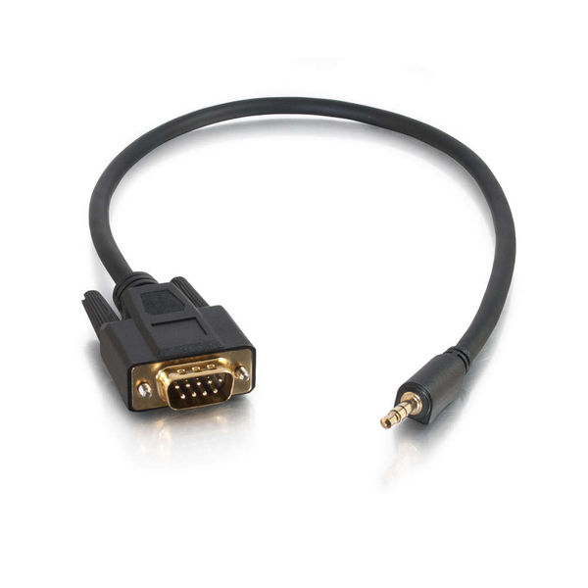
EX-LINK Pinouts
Samsung EX-LINK ports use a 3.5MM stereo audio style jack, Tip-Ring-Sleeve (TRS).
These can be adapted to standard DB9 connectors using off-the-shelf adapter cables.
1
2
3
4
5
S
R
T
6
7
8
9
Pin 2 / Tip = Received Data
Pin 3 / Ring = Transmitted Data
Pin 5 / Sleeve = Signal Ground

Slide 6
For more information, contact your local Samsung representative, or Brawn Consulting:
1 (866) 754-6450
samsunglfd@brawnconsulting.com
Jonathan Brawn
Principal
Brawn Consulting
E: jonathan@brawnconsulting.com
Brian Kosich
Engineering Services Manager
Brawn Consulting
E: brian@brawnconsulting.com
Thanks for Attending!

